Slide 1
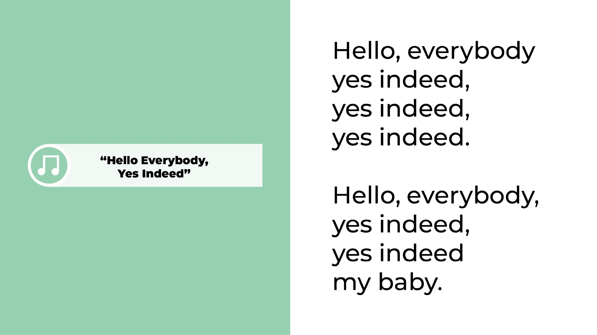

Slide 2
Notes:
Slide 2. Brain Basics
Let’s talk a little bit about the brain and how it works.
Our brain is full of cells, called neurons, and they look like that skinny little neuron. (Point to panel) When a child is born, there are billions of these neurons in the brain.
I’m going to show you how it works using my hands and arms. Think of the neuron as a tree.
The neuron has dendrite spines on each end.
These dendrites spines on the bottom look like the roots of a tree. (Use the pointer to show the roots) These “roots” send information to other neurons.
The tree trunk part is called the axon, (Use the pointer to show the axon) which transmits signals from the roots on the bottom to the dendrites on the top.(Use the pointer to show the dendrite spines)
This is the cell body. (Use the pointer to show the cell body)
The branch-like formations coming out of the cell body are the dendrite spines. They are like football players: They receive signals and then respond to the signals. Each time the roots of one neuron receive input from another neuron, their dendrite spines connect with the dendrites of the other. When this happens, a connection, called a synapse, is made. Each synapse adds weight to the neuron; the dendrite spines get bigger and thicker as they absorb new information, just like a sapling tree gets thicker roots and branches as it grows. (Use the pointer to show the synapses)
(STOP SCREEN SHARE!!!)
I will show you how learning takes place. Whoever is comfortable doing this, please make your hands into a neuron, like me. (Show them how to do it.)
These are the roots. (Wiggle fingers on bottom)
This is the axon. (Show arm)
This the cell body (Show palm)
And up here are the dendrite spines (Wiggle fingers)
Keep your neurons up and I will show you how synapses are made.
Imagine a baby is just coming out of the birth canal. As soon as he is born, the doctor puts the baby on his new parent’s tummy.
When Pete feels his parent’s skin, the roots of one neuron (Wiggle fingers of one hand) connect with the dendrite spines of another. (Wiggle fingers of the other hand) They don’t actually touch. (Intertwine fingers without actually touching each other) There is water in the brain that conducts something like an electrical connection called a synapse. It’s like the new information jumps from one neuron to another and adds weight by making the dendrite spines bigger and thicker. WHOOSH ! A connection is made! A synapse!
Everyone, create a connection between the roots on one neuron and the dendrites of another! (Intertwine fingers) WHOOSH
Pete smells his parent. (Intertwine fingers) WHOOSH ! Another connection is made.
More connections are made as the baby starts to nurse and tastes something new. (Intertwine fingers) WHOOSH!
Pete hears his parent’s voice calling him, “Sweetie,” and “my baby.” (Connect with another person) WHOOSH !
He feels the hugs he is getting.(Intertwine fingers) WHOOSH! Another new experience, another new synapse.
When Pete’s diaper is wet his and parent changes it, he feels taken care of. (Intertwine fingers) WHOOSH !
When he can’t sleep and his parent sings him a lullaby, Pete feels loved. (Intertwine fingers) WHOOSH !
Every time there’s a new experience, a synapse forms and the brain gains some weight. WHOOSH! is the synapse forming.
(With more people, you can add more connections such as “When mommy feeds” baby learns that “This person feeds me when I am hungry.” When baby cries and daddy rocks her, baby learns that “This person comforts me when I am upset.” When mommy gives a bath- this person helps me bathe, When daddy dresses baby - this person helps me get dressed, etc.)
When Pete’s parent says “I love you, Pete,” and “I love being your parent,” he learns to connect the word “parent” with all the previous experiences he’s had with this person. Each of these experiences add up to a definition of “parent”. Since nothing ever happens exactly the same way twice, every new experience the child has with his parents will expand his definitions of the word “parent”, adding new synapses. That’s why we say, “One experience builds upon another.”
The same thing happens when a baby has repeated interactions with an older sibling, grandparent, or any other close caregiver. (START SCREEN SHARE)

Slide 3
Notes:
Slide 3. Brain Growth
This picture shows the weight of the brain. As you can see, the brain is already gaining weight when the fetus is in utero. Can you see that the brain gains most of its weight between birth and age three, with the big curve continuing from ages 3-5? Each synapse or connection that is formed adds weight. People never stop learning, but you can see how the curve gets much lower after age 5. That’s because as we grow older, most of our synapses connect to the ones that are already there, rather than forming totally new ones. The new connections are much slower to form, so the brain gains less weight.
That is why what we do with our children in the earliest years makes a difference -- because the foundation of their brains is being built. This is the foundation on which social, emotional and economic success is based. And there are four simple things you can do to make a difference in your baby’s life: Talk, sing, share books and play.
Let’s tell our babies how we plan to help build their early literacy skills by singing the “Four Practices Song.”
Talk, sing, share books and play.
Talk, sing, share books and play.
Talk, sing, share books and play.
Talk, sing, share books and play. -- Hooray!
We’re going to be singing throughout the session, so please join in this time.
(Repeat)
--

Slide 5
Notes:
Slide 4. Reading to a Baby
From the library, you should have received this book, Hello My World, illustrated by Jannie Ho. It is for helping you sing, talk, and share books with your babies even before they are born.
Cardboard books are great for babies because they are not easy to destroy and are easy to clean. The thick pages can be sucked on, dribbled on, or chewed on, and they will remain intact. Simply wipe them off with a sani-wipe or a washcloth. Especially during COVID when we have to be super cautious about germs, a book that can easily be sanitized is a winner.
Black and white are the easiest colors for newborn babies to see up. (Show a few pages) According to the American Optometric Association, it is generally believed that babies have good color vision by 5 months old. When your baby is born, there is so much to see, to hear, to taste, to feel, and to touch that newborn brains often feel overwhelmed. It’s easier for babies to be introduced to pictures that their eyes can process. That’s why black and white images are the best books to share with your babies just after they are born.
But don’t wait until your baby is born to start sharing books; you can start reading to your baby right now! Fetuses can hear sounds as early as 20 weeks and become used to your voice while still in utero. Because they can hear your voice, reading and singing to them now is already beneficial. It’s a great way to introduce them to words. Although they can’t understand what you are saying and can’t see the book pages, you’re still building language and early literacy skills in whatever language you are using.
Fetuses hear different languages from inside the womb, and they can detect the different sounds of each language after birth So don’t be afraid of speaking to your child in more than one language; this is a boost to the brain and increases those synapses! Within hours after birth, babies can pick out their parents’ voices from others. Babies as young as two days old prefer the language they heard their parents speaking and singing when they were still in the womb, so sing songs in the language that is most comfortable for you. Research shows us that having a strong foundation in any language will make it easier for babies to learn English.
Choosing a special book or song to repeat during pregnancy creates a familiar ritual. These rituals are often comforting to newborns. After birth, babies recognize songs that were repeatedly sung to them and stories that were told or read over and over while they were in the womb. They recognize your voice and speech patterns from listening to the stories or songs you shared with them in utero.
No matter what your voice sounds like, to your baby it will be the most beautiful sound in the world. Reading aloud, singing and talking with your baby in the earliest years are practices that build language and early literacy skills. While the fetus does not learn actual words, it does recognize speech patterns and tones of voice. Don’t wait to share books until your baby is born. Lifelong reading and learning develops from the very beginning.

Slide 6
Notes:
Slide 5. Multiple Ways to Share Books
There are many different ways to share books. You can read an entire book from beginning to end or read just one or two pages aloud. Your baby might want to look at just one picture or page so you can simply talk about the pictures on that page. Your baby may even enjoy looking at the picture upside down, and that is fine!
Here’s an example.
(STOP SCREEN SHARE)
The first page in this book reads,“What’s going on bird?” (Show page)
But instead of reading the text, you can talk about the picture instead. You can say, “Here is a bird. And here are two legs (point to the legs). Here is one wing (point to a wing) and here is another wing (point to the other wing).”
“Is that bird smiling? I think so. Is she happy? She looks happy. Maybe she’s happy because she’s looking at you.”
Or, don’t talk about the bird at all! You can talk about the pattern on the opposite page: “Look at this page. I see black squares and white squares (pointing). It looks like a checkerboard! I used to play checkers with my grandpa.”
Most babies don’t have the attention span to sit and listen to an entire book. They DO enjoy hearing your voice and looking at one or more high-contrast pictures.
Connecting the pictures in books with words for everyday things in the world around us gives your babies building blocks for communication skills. That’s why talking about the pictures or pointing out some of the things you see is another important way to share books. It’s not always easy, though, to think of what to say about the pictures. So we are going to practice right now.
Open up the board book, choose a page, and start describing what you see or use the pictures to pretend to tell a story to “your baby.” There's no need to feel embarrassed. Since everyone is doing this, no one is going to be looking at you or listening to what you say. (especially since you are still going to be on mute!) We're just going to talk for about two minutes to give you a chance to practice sharing a book aloud without reading it.
(During the following minute, the facilitator should also be muted by quietly talk about a book page.)
(Ask the following questions and pause to give participants time to answer.)
Now you can unmute yourselves. Has anyone here done that before -- not reading a book aloud but talking about the pictures instead? Was it easy to do? Did you like doing it? What picture did you use and what did you talk about?
(SHARE SCREEN)

Slide 7
Notes:
Slide 6. Hello Sun, Yes Indeed
You may want to sing the book aloud to a familiar tune, such as this one (Give an example by singing a few pages to the tune of “Hello Everybody, yes indeed: using the text of the book.)
Sing:
Hello, sun, yes indeed, yes indeed, yes indeed.
Hello, sun, yes indeed, yes indeed my baby.
What’s going on, bird? Yes indeed, yes indeed, yes indeed.
What’s going on, bird? Yes indeed, yes indeed my baby.
Bonjour, flowers, yes, indeed, yes indeed, yes indeed.
Bonjour, flowers, yes indeed, yes indeed my baby.
What’s up, clouds? Yes indeed, yes indeed, yes indeed.
What’s up, clouds? Yes indeed, yes indeed my baby.
Remember that although your babies are still in utero, they can hear your voice and will begin paying attention to your words. By sharing books now, you will be much more comfortable sharing books after your babies are born, because you've already done it many times. You may even have your favorite pages!
Don’t forget that familiar things are comforting.Using recognizable words and sound patterns with newborns may give you additional ways to comfort them when they need calming.
Don't be surprised if your baby seems extra attentive or happy when you describe illustrations in the same way you did while you were still pregnant. It never gets boring to them! Children love repetition; sharing the same book every day in their youngest years of life encourages a love of learning and strong language skills. It is also a great way to play together on a daily basis.
You don’t need to speak loudly and you don’t need to talk about the book for a long time; 10 minutes a day is plenty!

Slide 8
Notes:
Slide 7. Body Rhymes
Once your babies are born, you will notice that they delight in looking at your face, especially when you look directly at them and smile. Here is a playful song about smiling. Start singing it now while you are pregnant, and continue singing it once your baby is born.
Sing:
I've got something in my pocket, it belongs across my face.
I keep it very close at hand, in a most convenient place.
I'm sure you couldn't guess it if you guessed a long, long while.
So I'll take it out and put it on, it's a Great Big Loving Smile!
Why is it important to smile at your babies and to create happy experiences with them?
Scientific studies have shown that children learn best when they feel safe and are happy. When experiences are worrisome - like when a parent says resentfully, “I have to read to you now” in an angry tone of voice, the baby learns to associate reading and books with negative feelings. But if sharing books together is a joyful experience that creates happy memories, your child will have happy associations with books and will want to learn how to read.
Sometimes in life we can have negative experiences, and that can affect a child very strongly. If the experiences you have with your child are positive, that can make a big difference!
Even now, when you are pregnant, when you talk, and sing, and read to your baby in a loving voice, your positive emotions can be felt. You may notice in our session today that some of the words in traditional songs have been changed; that’s because we want to make sure your baby feels wanted and loved.These joyful experiences will help form a sturdy foundation for what comes later because the brain WANTS to remember them.

Slide 9
Notes:
Slide 8. Name the Body Parts
Young babies love to look at their own body parts moving. Although they can’t control their movements yet, they enjoy seeing the ways their feet kick, arms wave, and toes wriggle. By naming the parts of the body and the movements they make through a song, you are helping your children build a useful vocabulary.
Instead of just looking down and singing to your belly, try doing the movements along with the song. You may feel your fetus’s movements increasing when you are singing or dancing. After your child is born, we have a continuation of this program called Mother Goose on the Loose Hatchlings: In the Nest. There, you will be able to do the movements together WITH your child.
Here’s a song that’s fun to sing when you feel your baby kicking you from the inside!
𝄞 Can you kick with two feet, two feet, two feet?
Can you kick with two feet? Kick, kick, kick, kick, kick.
(Continue with more verses: clap with two hands, wave with two arms, kiss with two lips.)
—Words and music: Barbara Cass-Beggs
If you just want to sing one verse, that’s fine. If you want to make up more verses, go ahead. Feel free to change the words. You can add in movements such as “Can you sway from side-to-side?” or “Can you wiggle with ten fingers?” The idea is to enjoy singing and moving, and to learn the song so you can remember to sing it with your baby often after birth.
If you’re not in the mood to sing, try reciting a rhyme instead. Clapping along to the beat makes it more playful. Be sure to clap softly! Sometimes, when you’re pregnant, you crave certain foods, like pizza! So let’s clap to this update of the rhyme “Pease Porridge Hot.”
Pizza, pizza hot. Pizza, pizza cold.
Pizza, pizza in the box, nine days old.
Some like it hot. Some like it cold.
Some like it in the box, nine days old. (Not me!) or (I do!)
You baby is enjoying your voice while hearing some new words. Let’s try it again. (Repeat)

Slide 11
Notes:
Slide 9. Hokey Pokey
Raise your hand if you like dancing. (Pause while people raise their hands.) I love dancing. Moving to music is good exercise and choosing music you love makes it even better. When babies are gently rocked or swayed, it reminds them of when they were in the womb, and it is comforting. One reason to learn songs well enough to feel you have them “in your pocket”, ready to be pulled out whenever you want, is that knowing songs makes it easy to sing and dance with your baby. Again, don’t wait! It is best to start singing and dancing with your baby now (as long as your pregnancy doesn’t have any restrictions).
Does anyone here know the Hokey Pokey? If you want to stand up and join in, that’s great. If you are just too tired or don’t want to stand up since your entire picture might not fit on the screen, feel free to stay seated and do the motions from your seat. The words have been changed to let your children know that you love them.
(STOP SCREEN SHARE)
𝄞You put your hand in, you take your hand out. (Put one hand in front)
You put your hand in and you shake it all about. (Put one hand in front)
You do the Hokey Pokey and you give a little shout: (Cup hands in front of mouth)
“I love you without a doubt.. Hug!” (Pretend to give your baby a hug)
Isn’t that a great way to help your child feel safe and loved? Let’s try another verse.
(You put your head in….)
(Sit down)
(SHARE SCREEN)

Slide 13
Notes:
Slide 10. Animal Songs
Who here is a professional singer? (Pause for people to respond) I’m not a professional singer. Sometimes I sing off-key. But I still sing to children and they don’t mind. To babies, their parent’s voice is the best voice ever. If they’ve heard your voice while in utero, they will especially love hearing it after they have been born.
Don’t worry about the quality of your singing. It doesn’t matter whether your voice is scratchy or off-key. Most people are not super singers. Singing to your baby is a gesture of love, because your baby knows and loves your voice best of all.
“The Wheels on the Bus” is a song many people know. Since I’m a librarian, I sing the last line as “On our way to the library.” Let’s sing the first verse together twice with the hand movements. If you don’t already know the song, you’ll be able to pick it up and sing along with us the second time. Again, I’ll sing it twice so if you don’t know it the first time, you can sing it with us the second time!
𝄞The wheels on the bus go ‘round and around,
‘Round and around, ‘round and around.
The wheels on the bus go ‘round and around,
On our way to the library.
If you want to use this song to prepare for an upcoming birth, you may want to sing “The wheels on the car go ‘round and around.. On our way to the hospital” or “birthing center”.
Since children love animals, once your baby is home, the lyrics can easily be changed to become an animal song. If you are walking down the street and you see a cat, you can sing the song like this:
(tune of “Wheels on the Bus”)
𝄞The cat that I see goes, “Meow, meow, meow.
Meow, meow, meow...meow, meow, meow.
The cat that I see goes, “Meow, meow, meow,
All through the day.
Or you can sing a song about a book illustration. In Hello, My World, there is a picture of a puppy. We can look at that and sing together (Sing with me!)
𝄞The puppy on the page goes, “Woof, woof, woof,
Woof, woof, woof...woof, woof, woof.
The puppy on the page goes, “Woof, woof, woof,
All through the day.
If you’re on your way to attend a Hatchlings program at the library and you see a truck, you can sing:
𝄞The truck in the street goes vroom, vroom, vroom.
Vroom, vroom, vroom...vroom, vroom, vroom.
The truck in the street goes vroom, vroom, vroom,
On our way to the library.

Slide 18
Notes:
Slide 11. Shakers
Is anyone here a musician? (If yes, ask what instrument they play) There are many simple items that you can turn into instruments. Look at this shaker I made. I had a plastic container with a lid, and I put some uncooked rice into it. When I shake it, it makes some cool sounds. (Shake it)
How else can you make a shaker? (Encourage ideas such as use a spice bottle with lentils, use an empty plastic bottle with rice inside, etc. If they are super enthusiastic and say they will go home and make them, put in a little pitch here for super-gluing the cap when sealing the bottle to make a shaker.) Because safety is of the utmost importance, before using a homemade shaker with a baby, show it to your baby’s pediatrician first to make sure that it is safe.
Depending on the materials you use, some shakers can be very loud (Shake an empty water bottle with beads) and some can be nice and soft (Shake an empty water bottle with uncooked rice). For today, please get a salt shaker, a plastic container with unpopped popcorn, or anything else that makes noise when you shake it. The shaker that I’m going to use is one that you will get as a gift for attending our “Hatchlings: In the Nest” program once your baby is born. “Hatchlings: In the Nest” will take place here after you’ve given birth. It is geared for babies between the ages of 2 to 6 months old, and will be held once a week for four weeks. Since you attended this Ready to Hatch program, you are invited to attend that series as well, even if your baby is not exactly in the age range when the sessions are taking place.
Many pediatricians recommend waiting until a baby is a couple of months old before going out in public, especially during flu and cold season. Please check with your pediatrician before you bring your baby to our program.
(Show the kit items when mentioned in the following paragraph)
When you come to Hatchlings: In the Nest with your baby, you will receive an entire kit as a present over the course of four weeks. There’s a frog puppet (Show), shakers like these (Show), another board book (Show), an indestructible book with beautiful animal pictures (Show), and a songbook with all the songs and rhymes used during all the Hatchlings: In the Nest sessions . If you don’t already have one, there’s also this early literacy calendar produced by the Maryland State Library (Show).
You will also another bag with the Mother Goose on the Loose logo on it, which becomes an easy place to store all of these supplies.
(Show your shaker.)
Because these shakers are small and make a soft sound, they are great for little babies. It's fun to sing songs and dance around with the shakers! There’s a song about shakers that I like, so I’ll sing it twice. Feel free to listen the first time and then sing along the second time, or do it with me both times.
(STOP SCREEN SHARE)
Hold up your shakers and shake along with me. The words are on the screen.
(Sing and shake)
𝄞 I have a little shaker, I’ll shake it in the air.
I’ll shake it over here. I’ll shake it over there.
It can be a carousel. Going round and round.
It can be a shooting star, falling to the ground.
I have a little shaker, I’ll shake it in the air.
I’ll shake it over here. I’ll shake it over there.
Okay everyone, do it with me. You can be as dramatic as you want! Have fun with this! (Repeat song)
𝄞I have a little shaker, I’ll shake it in the air.
I’ll shake it over here. I’ll shake it over there.
It can be a carousel. Going round and round.
It can be a shooting star, falling to the ground.
I have a little shaker, I’ll shake it in the air.
I’ll shake it over here. I’ll shake it over there.
If you’d like to join me, stand up and try dancing to it. See if you can be as silly as possible! Or you can still shake while sitting. It’s best to share these songs with your fetus and later on with your baby in ways that you enjoy. So if you like to dance or move creatively, now is your chance to shine! Feel free to turn off your camera if you are feeling shy, but don't’ forget to turn it back out when the song is over.
𝄞I have a little shaker, I’ll shake it in the air.
I’ll shake it over here. I’ll shake it over there.
It can be a carousel. Going round and round.
It can be a shooting star, falling to the ground.
I had a little shaker, I’ll shake it in the air.
I’ll shake it over here. I’ll shake it over there.
Don’t limit yourself to only singing children’s songs. Any song is good, even songs from different genres and music videos. Try to choose songs with the word love in them to let your baby know how much you care. Or change the original words to add in some words of affection. Can you think of any songs that would be good to dance to, that mention love or caring in them? What are they? (Give participants time to think and listen to their answers. If there is time and the group seems receptive, ask if they can sing a line or two from the song.)
When you are at home, if you hear a song that you like, try dancing to it. You don't need to limit your dancing to just one song. The more the merrier! Remember, combining music and movement together in an activity with your babies is so nourishing, it is like giving food to their brain. And if you are too tired to dance, that’s fine. Stay in your seat and add gentle movements like swaying from side to side. Your fetus will enjoy that too.
You can even sing a “clean up song” for putting the shakers back in the tote back. (Drop your shaker in the tote bag, singing, “Shakers away, shakers away, put your shakers away today.”)
(SHARE SCREEN)

Slide 19
Notes:
Slide 12. Lullabies
Whew! That dancing was tiring! Let’s sing a lullaby to relax ourselves.
The soft, slow pace of a lullaby helps both you and your baby to relax. Even the baby in your belly gets anxious sometimes.Since fetuses hear everything you say or sing, singing and humming a quiet lullaby can help them relax. They will probably recognize the lullaby when you sing it after they are born. Since all babies have their cranky moments, knowing a lullaby to calm them is essential.
If you know this song, please sing it along with me, slowly and softly.
Sing:
Twinkle, twinkle, little star.
How I wonder what you are.
Up above the world so high.
Like a diamond in the sky.
Twinkle, twinkle, little star.
How I wonder what you are.
If you didn’t already know that song, you know it now. Wasn’t that relaxing? Now let’s slowly rock from side to side as we sing the lullaby together. We can even hum it after we’ve sung it!
(Sing again and hum the song)
Feel free to substitute your own words to this melody. For instance, here are my words. If you have a doll or a stuffed animal, now is a good time to rock them as you sing! (Use a prop as your baby)
(STOP SCREEN SHARE)
Twinkle, twinkle, little star.
What a lively baby you are.
In my stomach very tight,
You keep me up all the night..
Twinkle, twinkle, little star.
What a lively baby you are!
Do you remember a lullaby that your parents or grandparents sang with you? If you do, and it is something that brings you a sense of comfort, then sing it to your baby! Since babies inside the womb hear what you are saying or singing, it is great to pass down traditional songs and stories that have been in your family for generations. This is a way to “honor the rich language and cultural traditions” in your family.
Any song can be a lullaby, as long as you sing it slowly and softly. Do remember that earlier we sang “The Wheels on the Bus” in different ways? It is a fast-paced song with movements that children love to sing. But if we slow it down and sing it softly, it can become a lullaby, too.
Let’s all take two deep breaths in and out. (Model this). Let’s close our eyes, hug ourselves and sway gently from side to side as we sing “The Wheels on the Bus”, so it will help us (and the fetus) to relax even more! Remember, lullabies don’t just help babies to relax, they help parents to relax as well! Let’s sing the first verse of“The Wheels on the Bus” as a lullaby, slowly and softly.
(Sing 1st verse of “The Wheels on the Bus” very slowly, gently rocking from side to side.)
𝄞The wheels on the bus go ‘round and around,
‘Round and around, ‘round and around.
The wheels on the bus go ‘round and around.
On our way to the library.
OPTION: Sing instead:
𝄞The wheels on the car go ‘round and around,
‘Round and around, ‘round and around.
The wheels on the car go ‘round and around.
On our way to the delivery room.
(SHARE SCREEN)

Slide 22
Notes:
Slide 13. Libraries
Presenting programs like these are part of the public libraries’ mission. We offer many free family programs that include songs, rhymes, puppets, and books. These free programs are a great way to follow up after attending both Hatchlings: Ready to Hatch and Hatchlings: In the Nest.
After your baby is born, when your baby is ready and it is not flu season, come to the library to join us for some programs. Many parent / baby library programs are similar to this. Attending programs is a great way to meet other new parents and find new ways to play with your baby. If you are not sure if your baby is healthy enough to go to the library, ask your pediatrician.
Don’t worry about your babies making noise; public libraries are no longer places where children are shushed or expected to sit still and be quiet. Children’s spaces in public libraries often include play areas and the librarians love seeing children playing with their parents and other children. Anyone can get a library card which allows you to borrow books and sometimes toys, games, movies and music! The job of public librarians is to help people find what they are looking for, so you can always feel comfortable asking questions.
Here’s a song about the library:
𝄞 Oh, the place for you and the place for me
is the local public library.
They have books and things that they lend for free.
It's the latest, it's the greatest, it's the library.
Educational, informational,
entertainment that's sensational.
It's a way of life, it's for you and me.
It's the latest, it's the greatest, it's the library.
(Dum ba da da da dum, dum dum)

Slide 23
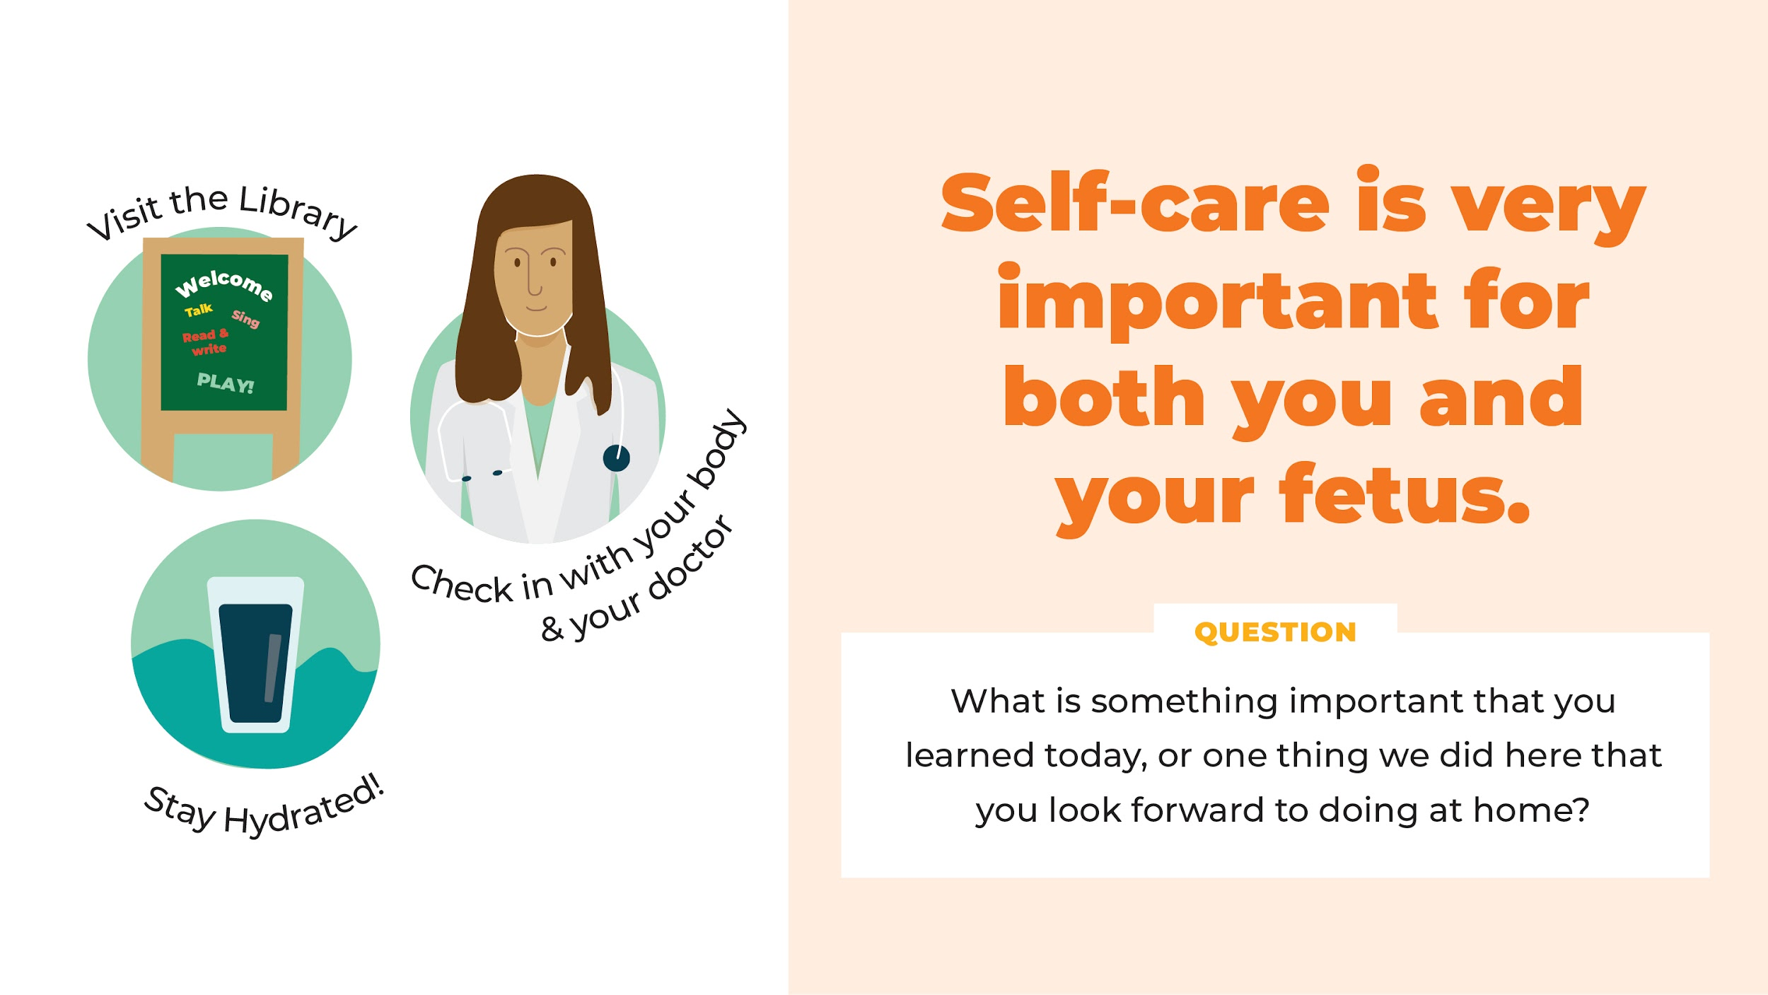
Notes:
Slide 14. Self Care
The library also has lots of books on pregnancy. Although I’m not a health professional, if you would like to learn more about your pregnancy, feel free to come to the library, call the library, email us, or even send a text. Librarians can help you find books and videos to help you learn more about your pregnancy and your fetus.
Self-care is very important for both you and your fetus during the pregnancy. Here are some helpful hints recommended by doctors: eating nutritious food and rest when you are tired. Walk carefully in the final months of your pregnancy since it can be hard to balance when you have a growing baby inside of a growing belly. Drink water so you don’t dehydrate, and go to your doctor or clinic for prenatal care. Would anyone like to share a self-care strategy that has helped them? (Pause and allow parents to each share a self-care strategy that has helped them. Remind them to unmute themselves.)
If you are feeling sad or get depressed after your baby is born, be sure to talk to your doctor. With your hormones raging, this is more common than you may think, and sometimes medical help is needed.
It’s also a good idea to choose a pediatrician for your baby and to meet him or her before the baby is born. Choosing a doctor can be very stressful, and the stress is eliminated if you’ve chosen a pediatrician ahead of your baby’s birth.
(STOP SCREEN SHARE)
I am your local librarian and I work at the library at (give address of the library) I’d love to see you there. You don’t need to wait until your baby is born to come and visit me. But once your baby is born, please come by and say “hello”. It will be wonderful to see you again and to meet your new baby. And once you’re there/here, you’ll have the opportunity to stay and join in some of our fun baby programs.

Slide 24
Take a book, a songsheet, and a “Hatchlings Headlines” handout.
Notes:
Slide 15. Questions
Does anyone have a question or questions about anything we’ve discussed today? (Pause and give people time to think before moving on.)
In the meantime, who would like to share something important that you learned today, or one thing we did here that you look forward to also doing at home? Let’s use the energy ball to hear from everyone.
(Ask who would like to start or chose someone.)
Hatchlings was created especially for parents-to-be, but there is more than just this one session! We will be offering this same session again on _______ (fill in with next date) and you are welcome to return although the content will remain the same.
Parents are their children's first and most important teacher even when they are still in the womb!
(SHARE SCREEN)
Hatchlings: In the Nest for you and your baby will begin on ______ (insert specific date), after your baby is born. As I mentioned earlier, it is a continuation of this program. It was designed for both you and your baby in the first four months. Hatchlings: In the Nest will be a four part series where you will learn new skills, songs, etc, and practice weekly what you learned the week before. In addition to the joy of practicing the activities with your baby, and spending more time together with other parents and children, you will get another cardboard book AND everything I showed you earlier that is in the Hatchlings kit, including the bag that holds all the items! We will contact you to remind you when sign-up is open for Hatchlings: In the Nest.
In addition to Hatchlings, please join us for library storytimes, virtually or in person. These joyful sessions offer opportunities for you and your baby to sing, talk, play, and share books together and they provide great ways to meet other parents and caregivers

Slide 25
Notes:
NOTE that the second to the last letter in the URL is a non-capitalized l (ell), not an “I” (eye) or a 1.
Slide 16. Closing
We’d like you to continue singing to your baby at home. Look at your song sheet; there is a web address and a QR code at the bottom, as well as at the bottom of this slide. If you have a smartphone, please scan in the QR code now. You’ll see that it takes you to a website where all of the songs we used today are recorded. If you forget any of the tunes, this is a great reminder! (Show them - https://mgol.net/mgol-hatchlings/songs-and-rhymes/)
We are coming to the end of our session. We hope that you found it entertaining and helpful. Since Hatchlings is a new program, we would like to know what you thought about it. Your honest feedback will help us tweak the program so we can make it even better! I’ll put a link in the chat box that will take you to an online evaluation form. If you have any difficulty with it, let me know and I’ll be happy to help you.
This is a “give and get.” Since you are helping us by giving us information, we hope you will take the book and song sheet that you are getting from us, and practice talking, singing aloud, reading or sharing books aloud and dancing at home.
Let’s end with a song about the easy things you can do to help your baby, even before birth and following that. Then I’d love to do a screenshot with everyone so we can have a group photo, even if it needs to be socially distanced.
Talk, sing, share books and play.
Talk, sing, share books and play.
Talk, sing, share books and play.
Talk, sing, share books and play -- Hooray!
(STOP SCREEN SHARE)
(Take picture, being sure to show name tags)
Feel free to stay awhile and talk more with me and the other program participants.
Thank you again for coming.

