Slide 1
Notes:
• Welcome to MGOL Hatchlings – In the Nest 4
• Introductions
• Your name, baby’s name & age, one thing you’d like to share about your baby or something you are now doing at home as a result of coming to Hatchlings.
• Fill out paperwork - (research & photos for articles and conference presentations)
• Reassure parents not to worry if their children make noise.
• Give guidance on what to do if a child start loudly crying or wailing
• Tell parents they don’t need to sit still either
• Don’t wake the baby!
• Your baby learns by imitating you
• Be enthusiastic / cell phones away
****
Welcome everyone and introduce yourself. Be sure to smile and speak in a friendly and informal manner.
Hello, everyone! Welcome to Mother Goose on the Loose: Hatchlings – In the Nest, Session 4. Thank you for being here. If appropriate: I’m glad to see familiar faces. I’m (say your name), a children’s librarian at the (say the name of your library), and I am delighted to see you here today. This version of Mother Goose on the Loose Hatchlings was created especially for new parents, like you.
Sharing books together, doing fun reading activities and reciting rhymes from the very beginning will benefit your child’s overall development. Parents are their children’s first and very important teacher, so this program is for you as well as for your babies. We’re going to be doing lots of singing and reciting; I expect you to join in singing the songs and reciting rhymes, even though you will be on mute. Learning together as a family is rewarding and powerful, so welcome!
Encourage everyone to introduce themselves and their babies.
I’d love to hear something about everyone here. I’m going to ask you to unmute and tell us your name and the name of your baby. You are also invited to tell us why you came to our program or one thing about your baby. For instance:
“I’m Avi and this is Mickey. He loves music. Whenever he hears music he kicks his feet.” Or “I am Susie, this is Olivia, and we sang songs to Wiggle! March! last week.”
Please keep your comments short. We can’t “go around the room” to do this, since the order of pictures on the Zoom screen keeps changing. To make it easy, call out each adult’s name one at a time. Please unmute you microphone and introduce yourself and your baby. Please keep your comments short. We’d love to hear more about you, but we’ll save that for the end of the program. (Give each person the opportunity to introduce him or herself. After each person says their name and their baby’s name, be sure to respond with “Welcome,” “Thank you for coming,” or “I’m glad you are here.” Make sure everyone gets a personal greeting from you. Be sure to have ALL adults introduce themselves, i.e. other library staff members, visitors from the Hatchlings steering committee, grandparents, etc. As each person shares, put a check after their name.)
Fill out paperwork
In order to make this program as good as possible, we have requested your feedback by filling out a survey at the end of the program. If you haven’t already filled out the consent form, please do it now. The link to the consent form is in the chat box. The link to the survey will be in the chat box once the program finishes. Thank you for helping us in this way
Tell them what they’ll get to take home
Hatchlings includes a lot of materials. I hope you have gotten your “kit” from the library. If not, let us know and we will make sure that you get one. Please don’t try to take notes during the session. To help you relax and enjoy being here with your baby, at the end of the session you will get Hatchlings Highlights, a booklet with pictures of each panel or this powerpoint to remind you of everything we spoke about. If you don’t yet have the Hatchling’s song book, let us know and we’ll make sure you get one of those also.
Reassure parents not to worry if their children make noise
Babies like to wiggle, cry, make noises, fall asleep or many other things. They’re babies; being unpredictable is what babies do! If your baby is crying, feel free to mute yourself (if you are not already muted). All babies cry at some point, and we all know what it is like! If you feel uncomfortable being on video, turn your camera off. But, please turn your camera back on as soon as your baby is ready
Don’t wake the baby!
Babies need their sleep! If your babies are asleep or fall asleep during the program, please don’t wake them up! Sleep is important for their growth and for their health. Just continue to sing and join in with the activities. If you have a stuffed animal or doll nearby, you may want to practice with that. Then you’ll be all ready to do the activities with your babies when they wake up.
Tell parents they don’t need to sit still either
If you need to get up and walk with your baby or rock your baby, that’s absolutely fine.
How your baby can participate
Even though your babies won’t be able to do the activities because they don’t yet have the coordination to move their fingers, clap, or sing along, it’s important for them to see you doing everything. They can participate by exploring the props, even if it’s with their mouths! And, of course, they love watching you.
Taking care of your baby’s needs
Feel free to feed or nurse your baby during the program. We are comfortable as long as you are comfortable. If you need to change a diaper, go ahead! If you need to hide your video for awhile, that’s fine. But when you’re ready, please, return!
Be enthusiastic / cell phones away
Parents are their babies’ first teachers. Babies learn the most by imitating the people they love. In order for your babies to get the most out of this program, it’s important for you to do all the rhymes and motions with me, in an enthusiastic manner. So, please put your cell phones away or on silent. Your enthusiasm for anything -- a book or toy or a pretty leaf -- teaches your babies that there is a world of things to be interested in. It will encourage them to explore more of the world.

Slide 2
Notes:
• The more words your child knows, the easier it will be to learn to read
• Children learn words when you talk, sing, share books, and play with them.
• “Talk, sing, share books and play”
• “Old Mother Goose when she wanted to wander, would fly through the air on a very fine gander.”
*****
Studies show that the number of words children know and can use when entering kindergarten affects their entire education, making it easier for them to learn how to read. And it’s easy to help your child build a large vocabulary; just talk, sing, share books and play with your child, starting from the very first moments you have together. Here’s a song to remind you what to do:
Talk, sing, share books, and play.
Talk, sing, share books, and play.
Talk, sing, share books, and play.
Talk, sing, share books, and play -- Hooray!
Sing it with me! (Repeat)
During the rest of the program, I will recite each rhyme twice. The first time you can listen; the second time, recite the rhyme along with me. If you already know the rhyme, please feel free to say it both times.
Old Mother Goose when she wanted to wander
would fly through the air on her very fine gander.
(Repeat)

Slide 3
Notes:
• Happy Baby & Hello MyWorld
• Tummy time strengthens baby’s head, neck and upper body muscles. It can be on a blanket or chest-to chest.
• Describe to your baby what you see in the picture.
• Talking teaches the names of things.
• Describing emotions will help your baby have words to communicate feelings.
• Looking at pictures trains eyes for reading.
• Run in the rain, open the umbrella.
*****
In each Hatchlings session, we’ve used this book, Happy Baby. (show book) We talked about the black and white illustrations for newborns who enjoy high contrast pictures and the colorful faces for older babies. We also spoke about the importance of Tummy Time, when babies spend time on their tummies and look up at interesting objects. This strengthens their head, neck, and upper body muscles.
If your baby is up for it, place a blanket on the floor. Take Hello, My World out of your kit and open up the book into the accordion fold with the pictures of children’s faces facing the blanket. Place your baby on the blanket, belly down. (show an example) If your baby doesn’t like tummy time, when you’re at home, try lying chest-to-chest. Tummy Time is a perfect time for talking and playing with books and other toys.
One of the illustrations in Hello, My World shows a happy looking puppy. You might want to describe aloud what you think your baby is seeing. Let’s take a moment to pull the book out of our kits, open it to the puppy picture, and talk about it with our babies.
(Pause 2 minutes for activity)
Talking or singing about the pictures you see in a book teaches your children the names of things.Talking about the expressions on the babies’ faces in the book labels the emotions and gives names to different feelings. It is easiest to soothe a crying baby if you know why they are crying. Is it hunger? Teething? A wet diaper? Giving your babies words to express emotions or problems will help them communicate with you when they are able to talk.
Your baby’s eyes move across a line to look from one picture to another. This is what they also do to read a sentence from beginning to end. These movements strengthen and train eye muscles. When we show pictures to our babies, they pick up cues to look at pictures in a certain direction and to focus on them.
Here’s a picture of rain coming down from a cloud. You can tell a story about it. It’s easiest for your baby to understand if you start with the main word. For instance: “Rain. It’s a rainy day. The rain is pouring down. See the cloud? The rain is pouring down from the cloud.”
Or you can play with the idea of rain. Try tapping your fingers very gently on your baby’s forehead and saying “It’s raining. It’s raining! We need an umbrella. Quick, let’s get out of the rain.” Then pretend to run for an umbrella, moving your finger feet very quickly
Pick up your baby and let’s try that together. (Pause while parents pick up their babies)
Start by tapping your fingers very gently on your baby’s forehead like raindrops. Then tell the story: “It’s raining. It’s raining! We need an umbrella. Quick, let’s get out of the rain.” (Move baby’s legs in a gentle running motion)
We can also sing about rain. Does anyone know a rain song?
(Pause for answers)

Slide 4
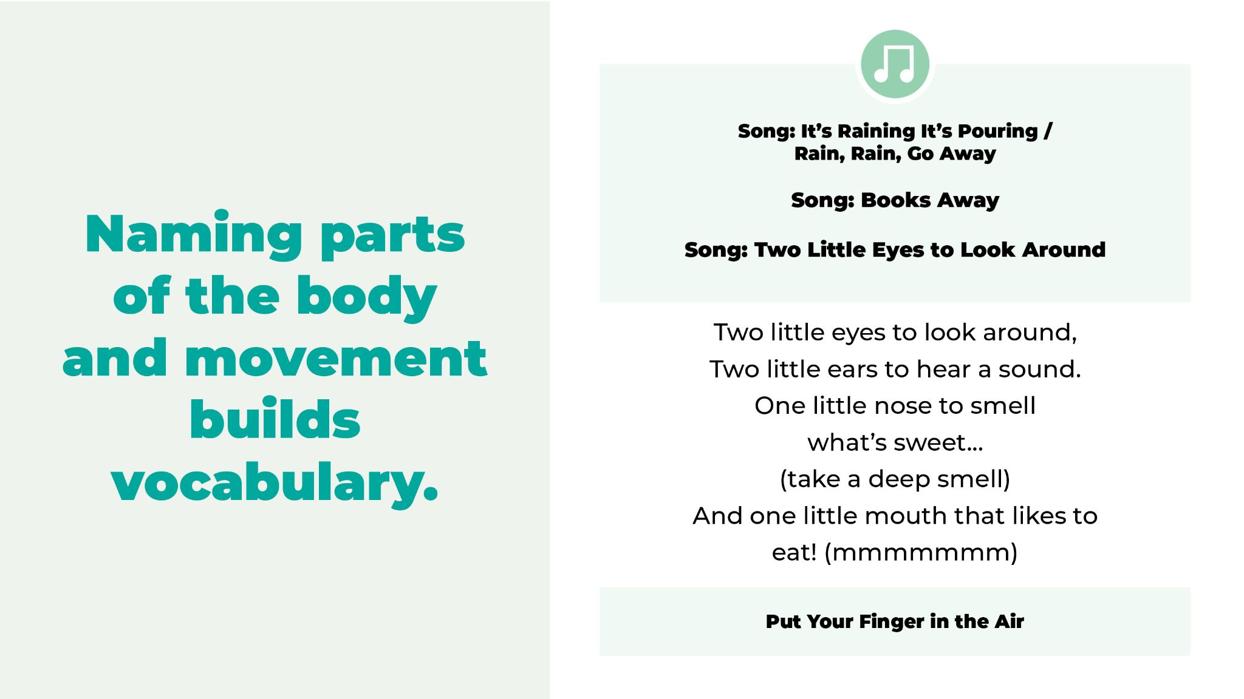
Notes:
• “It’s Raining It’s Pouring / Rain, Rain, Go Away”
• “It’s Raining It’s Pouring”
• “Books Away”
• Naming parts of the body and movement builds vocabulary.
• “Two Little Eyes”
• “Put Your Finger in the Air”
*****
Here’s a nursery rhyme song:
It’s raining, it’s pouring.
The old man is snoring.
He knocked his head when he went to bed,
And it grew to a bump in the morning.
Rain, rain go away, come again another day (2x)
Let’s sing it together. (Repeat)
Each week, we’ve told you to feel free to change the words to the rhymes or songs. Here’s an adapted version of “It’s Raining, It’s Pouring” written from the point of view of an active baby who wakes up very early in the morning. I’ll sing it twice so you can listen the first time and sing it with me the second time. The words are also in the Hatchlings’ song book, so if you like it, you can sing it at home!
It’s raining, it’s pouring,
So I can’t go exploring.
I’ll go to bed with a kiss on my head (kiss baby)
And I’ll wake up my parent(s) in the morning.
Sing it with me now!
It’s raining, it’s pouring,
So I can’t go exploring.
I’ll go to bed with a kiss on my head (kiss baby)
And I’ll wake up my parent(s) in the morning.
Please put Hello, My World back into your kits.
Books away, books away, put your books away today.
Books away, books away, put your books away today
(Repeat as often as necessary until all books are collected.)
For babies, there’s no better way to develop a sense of self, a sense of identity, than to look at their hands and feet and see how they move. After a while, they realize, “That’s me!” When you say “Is that your foot?” or “Is that your foot wiggling?” They are already learning a noun and a verb. They love looking at themselves in a mirror. “There’s me again!” And when you say, “There’s Kaya!,” they get to know who they are even better.
Naming the parts of the body and the movements they make through a song helps your children build a useful vocabulary.
Two little eyes to look around, (point)
Two little ears to hear a sound. (point)
One little nose to smell what’s sweet... (take a deep smell)
And one little mouth that likes to eat. (make nom nom noises)
(Repeat)
Here’s another song about body parts:
Put your finger in the air, in the air. (2x)
Put your finger in the air.
And wave it way up there.
Put your finger in the air, in the air.
Put your finger on your nose, on your nose. (2x)
Put your finger on your nose.
Now touch it to your toes,
Put your finger on your nose, on your nose.
Put your finger on your knee, on your knee. (2x)
Put your finger on your knee.
Count together: one, two three.
Put your finger on your knee, on your knee.
Sing these songs as much as you like. Children learn more each time they hear a song, a rhyme, a word or a story. They won’t get bored! The more you sing to them, the better

Slide 5
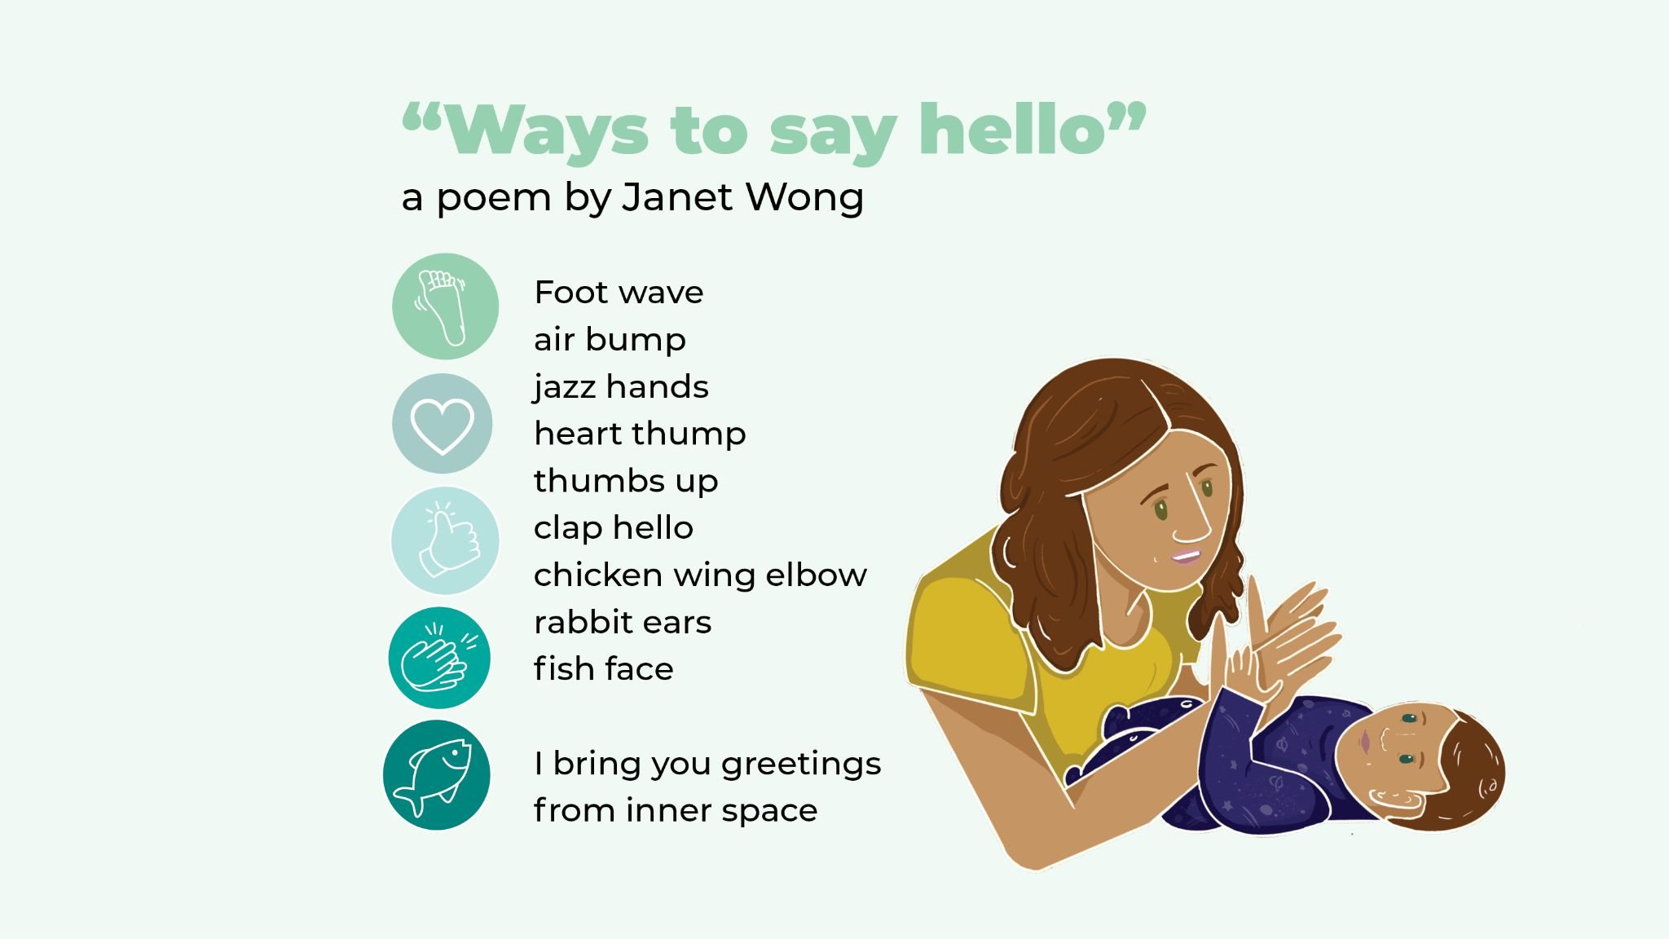
Notes:
Janet Wong’s poem, “Ways to Say Hello” uses rich words to describe ways that body parts move. Acting it out shows your baby what the words mean. Make the movements yourself or help your baby to make the movements!
Foot wave
air bump
jazz hands
heart thump
thumbs up
clap hello
chicken wing elbow
rabbit ears
fish face
I bring you greetings
from inner space
Let’s end the poem with a big hug, giving our babies a warm and safe inner space. (Hug!)
And again! (Repeat)
Here’s one more song that names body parts and what they do

Slide 6
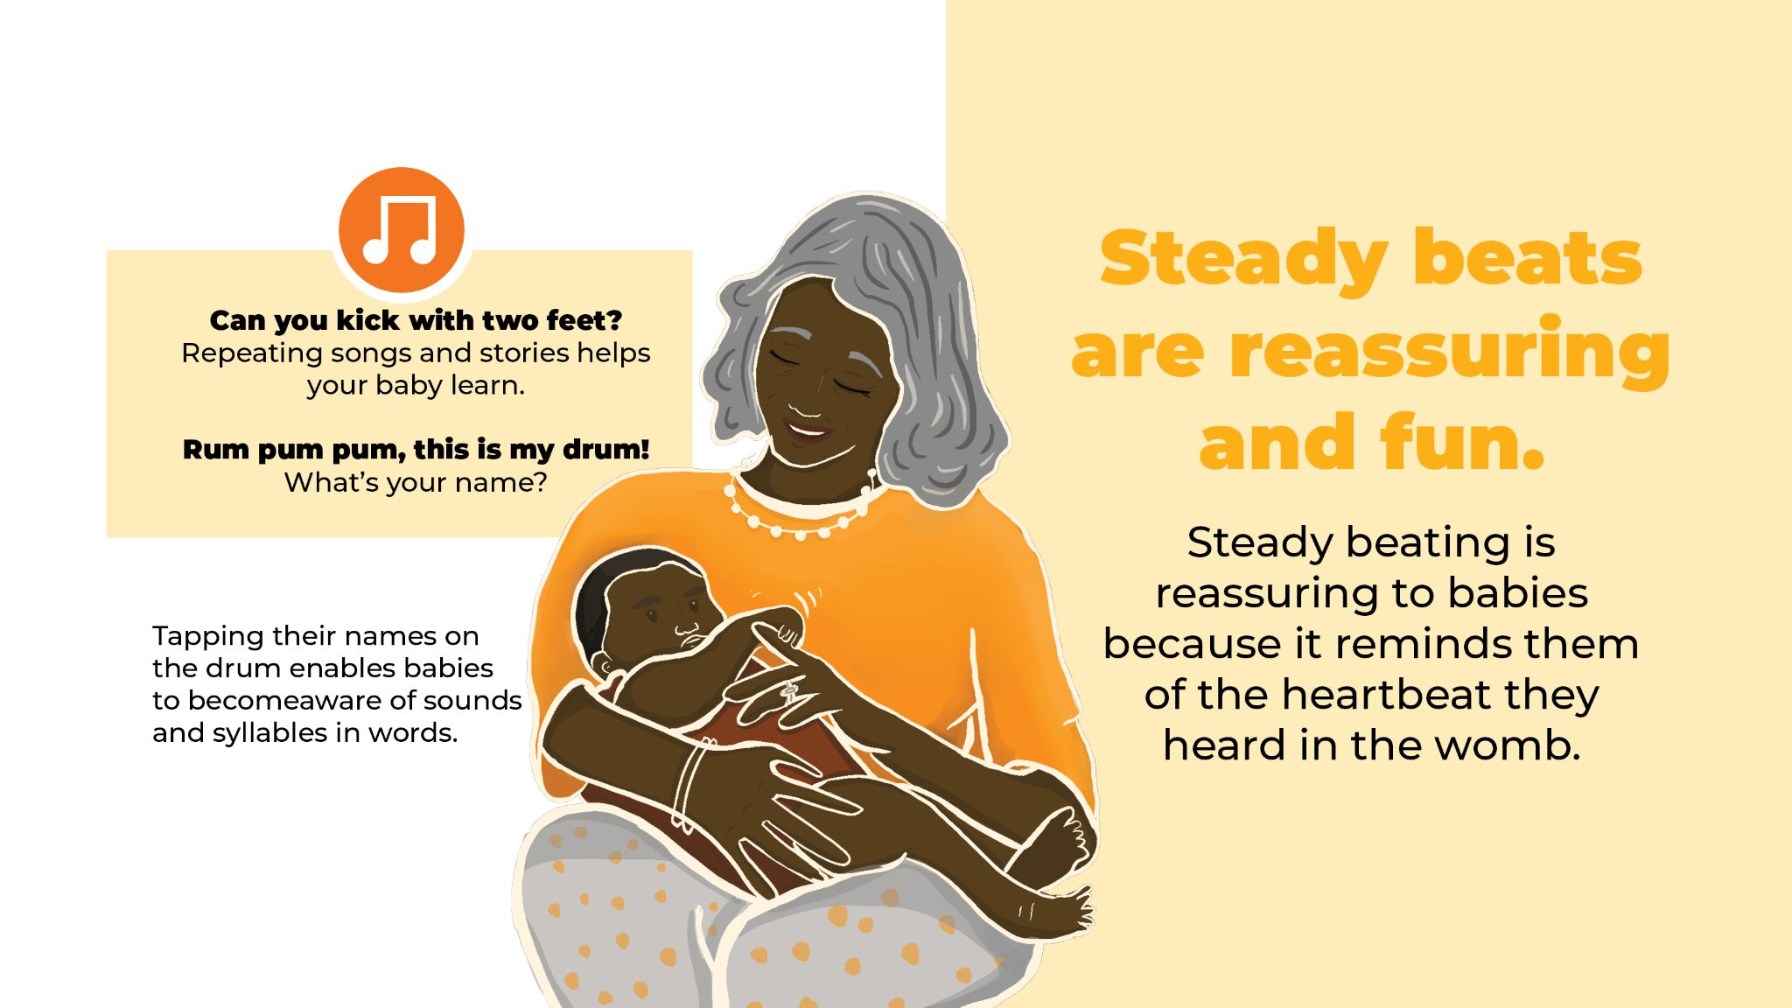
Notes:
• “Can You Kick with Two Feet?”
• Repeating songs and stories helps your baby learn.
• Steady beats are reassuring, bounces are fun.
• Drum Sequence
• “Rum Pum Pum, This is My Drum!”
• What’s your name?
• Tapping out the sounds in words = hearing syllables
*****
Can you kick with two feet, two feet, two feet?
Can you kick with two feet, kick, kick, kick, kick, kick.
Can you clap with two hands, two hands, two hands?
Can you clap with two hands, clap, clap, clap, clap, clap.
Can you wave with two arms, two arms, two arms?
Can you wave with two arms, wave, wave, wave, wave, wave
(Continue with: wiggle with ten fingers, kiss with two lips, etc.)
Sing this often and you’ll see your baby start to imitate your gestures. When you read books or sing songs over and over, your baby soon learns what comes next. The repetition will familiarize your baby with all of the repeated elements.
Take out a tambourine or hand drum.
Let’s take out the Hello, My World Book. Let’s use our imagination and pretend that our books are drums.
Rum pum pum. This is my drum. (Tap to the beat.)
Rum pum pum. This is my drum.
My name is _____. What’s your name? (Tap your name with syllables on the drum. )
If we were together, I would I walk around the circle and ask each baby to tap his or her name on the drum with syllables, with your help. For instance, Joe would just be Joe, but Shaniqua would be Sha-ni-qua with three syllables. (Demonstrate as you say the names.)
Tapping out names helps children to become aware of syllables and the sounds in words. What word do babies know best? Their own name! So, please unmute yourselves. After I tap out my own name, I’ll call each adult’s name one by one and recite Rum Pum pum. When it’s your turn, please use Hello, My World as a drum and do this rhyme along with me. Tap your name on the drum, and then gently lift your baby’s hand and help them tap out their own names, too. That way, they feel the syllables as well as hearing them.
Rum pum pum. This is my drum. (Tap to the beat.)
Rum pum pum. This is my drum.
My name is _____. What’s your name? (Tap your name with syllables on the drum. )
What’s your name? (Hold out drum and pause for an answer)
Hello, ___.(If you hear the spoken name, then repeat it back)
What’s your name? (Hold out drum and pause for an answer. If you don’t hear the name, just give a greeting)
I’m so glad you’re here.
What’s your name? (Hold out drum and pause for an answer)
Glad to see you, ___.
(You may want to ask everyone to unmute and take turns, or just have everyone do this at the time same, unmuted. Then, in the same sing-song voice, say:) Everybody, Stand up!

Slide 7
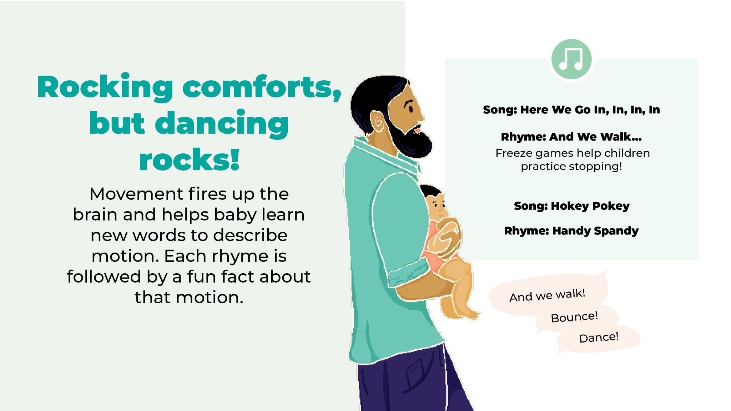
Notes:
• “Here We Go In, In, In, In”
• Freeze games help children practice stopping!
• “And we walk…”
• Other movement words?
• “Hokey Pokey” (from Panel 7, session 2) “without a doubt”
• Share songs that you remember
• “Handy Spandy”
*****
Time to do a dance!
Point to the center of the circle. Then start moving and singing without needing to give an explanation.)
Here we go in, in, in
Here we go out, out, out.
Here we go in, in, in
And we turn ourselves about.
Here we go up, up, up, up.
And here we go down, down, down, down.
Here we go up, up, up, up.
With the sweetest baby in town. (end with a few kisses)
(Repeat)
- Barbara Cass-Beggs
Let’s walk around the room. Hold your baby in your arms, and let’s walk together.
And we walk, and we walk, and we walk, and we stop.
And we walk, and we walk, and we walk, and we stop.
And we walk, and we walk, and we walk, and we stop.
And we all turn around — WOOOOOOOOOO
Now let’s bend down and creep very quietly.
And we creep, and we creep, and we creep, and we stop.
And we creep, and we creep, and we creep, and we stop.
And we creep, and we creep, and we creep, and we stop.
And we all turn around — WOOOOOOOOOO!
When you’re playing this freeze game at home, don’t limit yourself to “walk” and “creep.” There are many more movement words that you can use, as long as you remember to move gently with your baby. Can anyone name other movement words? (Pause for answers like sway, hug, and rock. Point out words that may be too energetic for a young baby.)
Here’s another example of playful ways to teach your baby the names of body parts, The Hokey Pokey! Instead of the traditional last line, let’s sing, “I love you without a doubt. Hug!”
You put your hand in, you take your hand out.
You put your hand in and you shake it all about.
You do the Hokey Pokey and you give a little shout.
I love you without a doubt.. Hug!
(Pretend to give your baby a hug)
(You put your foot in…., head in…. whole self….)
The “Hokey Pokey” may remind you of other songs and rhymes you learned as a child. See if you can remember them and add them to your singing time with your baby. Songs and rhymes often come in handy when your babies are fussy and walking around is the only thing that will calm them. Songs in any language are fine. Sharing songs that your parents or grandparents sang to you is a great way to pass on some wonderful family traditions.
Using more than one language with babies is not confusing. At this early age, their brain is like a sponge and they are absorbing everything. Children can learn two languages at the same time. Not only can a four month old tell the difference between languages, but studies have shown that people with bilingual brains find it easier to pay attention and switch from one task to another. Being bilingual not only helps children but often results in benefits to their entire family
(Go immediately into the next rhyme without any introduction)
Handy Spandy, naptime is dandy, we all walk in.
Handy Spandy, naptime is dandy, we all walk out.
Handy Spandy, naptime is dandy, we turn around.
Handy Spandy, naptime is dandy, we all sit down.

Slide 8
Notes:
• Wiggle! March!
• Sing an animal song.
• Talk and sing about daily life:
• “I Went to Visit the Store One Day”
I saw a carrot along the way.
What color was the carrot that day?
Orange, orange, orange
• Did anyone use this song last week?
• New ideas for this song?
• What else can we sing about?
• “Books Away”
*****
Please take this book out of your kits. (Hold up Wiggle! March!) In the past few sessions, we have talked about the pictures, made up stories around the pictures, and sung songs about the animals. Can anyone think of a new animal song that we haven’t sung yet? (Pause for answers. If no-one answers, suggest Old MacDonald and sing two verses. Or, you can sing the same song that has been sung every week, “I Went to Visit the Farm.”)
(Limit singing to 3 or 4 animals)
I went to visit the farm one day.
I saw a duck across the way.
And what do you think the duck did say?
“Quack, quack, quack.”
(Sheep…baaa, pig…oink, horse…neigh)
Last week, I mentioned talking and singing about the ordinary things you do. I gave this example:
I went to visit the store one day,
I saw a carrot along the way.
What color was the carrot that day?
Orange, orange, orange.
Sing it with me!
I went to visit the store one day,
I saw a carrot along the way.
What color was the carrot that day?
Orange, orange, orange.
Did anyone try using the song to tell your baby about a place you were visiting this past week? If so, could you please tell us about it? We can always use new ideas! (Pause and unmute if there are volunteers. Put everyone back on mute to continue. )
Put your books back in the bag and then take out your frog puppets.
Books away, books away, put your books away today.
Books away, books away, put your books away today.

Slide 9
Notes:
• “I Dropped my Frog” • This week’s gift: the frog puppet!!! • Little Frog On a Log
Little frog, on a log
Sings his song, all day long.
Ribbit, Ribbit, Ribbit,
Ribbit, Ribbit, Ribbit (Kisses)
• Song & rhyme booklet • “Frogs Away”
*****
Hold your frog puppets in front of you! If you think your baby needs some entertainment, sing this song with your frog puppet. Stuffed animals and puppets make singing even more fun!
(Hold up the frog puppet, put it on your head and start singing.)
I dropped my frog, pick it up, pick it up. (Drop frog in lap)
I dropped my frog, pick it up, pick it up.
I dropped my frog, pick it up, pick it up.
And put it on my tummy. (Put frog puppet on stomach)
I dropped my frog, pick it up, pick it up.
I dropped my frog, pick it up, pick it up.
I dropped my frog, pick it up, pick it up.
And put it on my shoulder. (Continue as long as you want with different body parts!)
Let’s do one more frog rhyme. Put the frog on one of your fingers. Use your other arm as the log.
Little frog, on a log
Sings his song, all day long.
Ribbit, Ribbit, Ribbit,
Ribbit, Ribbit, Ribbit (Kisses to your baby can be used in place of the word “Ribbit!)
Let’s do that again! (Repeat)
If you don’t already have a song & rhyme booklet (show one) there are links to websites where you can hear and see someone using it, so you don’t have to worry about forgetting the tunes or actions. We hope you will continue singing the songs and reciting the rhymes at home with your babies.
Let’s sing the clean-up song to drop our puppets back into the bag. You can use this song or something similar to encourage your children to clean up when they are bigger!
Frogs away, frogs away, put your frogs away today.
Frogs away, frogs away, put your frogs away today.
(Sing as many times as needed)

Slide 10
Notes:
• Babies are scientists, exploring everything
• “We All Shake Our Shakers” • “I’ve Got Something in My Pocket” • “I Have a Little Shaker • Always supervise babies with props
- be aware of choking hazards
• Children learn best through exploration (study about the toy)
• “Shakers Away”
*****
Please take your shakers out of your kit. There should be one for you and one for your child. If possible, let your babies hold their shakers while watching you shake your shaker. They will explore how it feels, what it does, and how it sounds. Although it seems that your baby isn’t doing more than simply holding it or tasting it, they are gathering information like scientists, which helps their brains develop even though they are so little. Don’t worry, soon enough your child will be shaking it around to the beat!
We’ll all shake our shakers, we’ll all shake our shakers,
We’ll all shake our shakers because it’s fun to do.
We’ll all shake our shakers, we’ll all shake our shakers,
We’ll all shake our shakers because it’s fun to do.
Shake them up high. (shake up high in a high voice)
Shake them down low. (shake down low in a low voice)
And shake them in the middle.
(shake in front, using a normal voice)
And again! (Repeat)
Now let’s put a smile on baby’s face.
I’ve got something in my pocket, it belongs across my face.
I keep it very close at hand, in a most convenient place.
I’m sure you couldn’t guess it if you guessed a long, long while.
So I’ll take it out and put it on, it’s a Great Big Loving Smile!
(Repeat)
Baby smiling at you, you smiling at baby — this type of interaction can foster that sense of continuity, closeness and connection. But don’t worry if your baby isn’t smiling at you yet; it takes a while for those muscles to develop!
Here’s a new shaker song. Try it with me.
I have a little shaker, I’ll shake it in the air.
I’ll shake it over here. I’ll shake it over there.
It can be a carousel, going round and round.
It can be a shooting star, falling to the ground.
I have a little shaker, I’ll shake it in the air.
I’ll shake it over here. I’ll shake it over there.
(Repeat)
Isn’t that playful? Play is important because babies learn best by interacting with you and by discovering things on their own. Although we don’t have time here, when you are home, try to give your baby time to play with the shaker WITHOUT imitating you. Of course, supervise your babies if they are holding a prop! You must always be careful about choking hazards with babies and not leave them unattended with toys. But giving them something to play with, without telling or showing them what to do, builds their learning in a different way.
In a scientific study with two groups of preschool children, a teacher introduced a toy that did many different things. In one group, the teacher showed the children a couple of things that the toy did, but did not show them everything. In the other group, she left the children alone to play with the toy without showing them anything. The children in the first group imitated what the teacher had done and then quickly got bored and stopped playing with it. In the group where the children didn’t know what was supposed to happen, they explored on their own and discovered more of the different things the toy could do than the children in the first group. They also played longer with the toy.
That’s why we need to make sure our babies have time to explore on their own terms in addition to the time they are interacting with us. We need to supervise to make sure they don’t choke on little objects or do something dangerous, but even at this young age, their minds are active and they learn best by doing.
(Show by example – put your shaker back in the kit and sing the following song)
Shakers away, shakers away, put your shakers away today.
Shakers away, shakers away, put your shakers away today.
(Sing as many times as needed.)
Sing to your child about putting shakers away, dolls away, clothes away, anything fits into this clean-up song!

Slide 11
Notes:
• Singing lullabies calms and relaxes babies.
• Rocking motions and hearing your heartbeat calms them.
• Use your baby’s name!
• “Too Ra Loo Ra Loo Ra”
*****
At the sweetest time of the day, it’s wonderful to hold your babies close so they can hear your heartbeat and sing a lullaby. It’s a time to sing a love song to your little one, using new words to an old tune. Rock gently from side to side while singing this lullaby. Feel free to substitute your baby’s name in place of the word “hatchling.”
Too Ra Loo Ra Loo Ra,
Too Ra Loo Ra Lie,
You’re my little hatchling
so here’s a lullaby.
Too Ra Loo Ra Loo Ra,
Too Ra Loo Ra Lie,
Let’s both relax together, resting -
you and I.
Your baby hears everything you say, or sing, so singing and humming a quiet lullaby can be effective. And the soft, slow pace of the melody helps you and your baby to relax. Let’s try humming one verse of this song. (hum)

Slide 12
Notes:
• Libraries are places for finding answers to your questions.
• Librarians help people find what they are looking for
• Libraries welcome parents and babies
• You can meet other families with babies at the library.
• Meet future friends during library programs.
*****
I’m so glad you were able to participate in this session from your home / at our library / the Judy Center/ this location.
Please come visit me at the library, too! A library is a place for finding answers to your questions, about your babies or anything else. A librarian’s job is to help people find what they are looking for, so you can always feel comfortable asking questions. And we have programs for you and your baby, so you don’t have to worry about a babysitter. You’ll meet other families with babies, future friends in the making.
(If you have upcoming programs, bring flyers or mention the program, date, and time.)

Slide 13
Notes:
Singing songs exposes your child to new words.
Sing the library song
*****
The more words your baby hears, the better. The library song has lots of exciting words that your baby will hear now and learn to understand later.
“Library Song” (with lyrics)
Oh, the place for you
and the place for me
is the local public library.
They have books and things
that they lend for free.
It’s the latest, it’s the greatest,
it’s the library.
---
Educational, informational,
Entertainment that’s sensational
It’s a way of life, it’s for you and me
It’s the latest, it’s the greatest,
it’s the library.
(Dum ba da da da dum, dum dum)
Get a library card and become a regular! We’d love to see you!

Slide 14
Notes:
• Parents are their babies’ first and very important teachers.
• Watch carefully when your baby plays with the frog puppet.
• Play with the puppet or shaker should always be supervised.
• Share something about your experience today, or about the Hatchlings program. Do you sing, talk, share books, or talk more with your baby?
• “My Little Baby is Going to Sleep”
*****
Hatchlings: In the Nest was created especially for new parents and their babies, because parents are their babies’ first and very important teachers. Today was our last session! Babies — I hope you enjoyed coming. Parents — I hope you enjoyed coming, too! We certainly enjoyed singing and talking with you. We hope will leave with good, practical information and ideas.
I’d like to remind to you that although the frog puppets are fun to use with babies, they can present a choking hazard if left alone with children under age 3. So, do not let your baby play with the puppet unless you are watching carefully. Constant supervision is needed for using these puppets and the shakers with the babies.
Also, have a look at the early literacy calendar that came along with your kit. These “Day by Day” calendars produced by the Maryland State Library with funding from the U.S. Institute of Museum and Library Services suggests fun, literacy building activities that you can do with your baby every day of the year! You can fill in the actual day of each month, so the calendar never goes out of date (show an example). Also, the illustrations are beautiful!
Let’s share some thoughts one last time. Can each person share something about your experience today, or about the Hatchlings program as a whole? I know you have been completing evaluation surveys for us, but we thought it might be nice for you to share with one another since this is our last program. (Unmute everyone and pause for answers)
Have you seen singing and reading change your baby’s behavior in any way? What did that look like? (Unmute everyone and pause for answers. Then mute everyone)
Today, we’re going to end with a lullaby. It’s in your song book, so if you like it, you can continue singing it at home. It’s easy to pick up and it has four verses, so I’m only going to sing it once and I hope you’ll join in. Please hold and rock your babies for this last song.
My little baby is going to sleep. (3x)
Bye love, bye love, sleep, sleep, sleep.
Ten little fingers are lying at rest. (3x)
Bye love, bye love, sleep, sleep, sleep.
Ten little toes are curling up tight. (3x)
Bye love, bye love, sleep, sleep, sleep.
Two little eyes are closing up tight. (3x)
Bye love, bye love, sleep, sleep, sleep.
- Barbara Cass-Beggs

Slide 15
Notes:
• Questions?
• Please fill out exit surveys
• Thank you for coming! We’re glad you were here.
• Please join us again next week!
*****
I hope you found today’s session fun, with lots of good information. Can you please share in the chat or unmute yourself and tell us one new idea or action from this session that you hope to practice at home with your baby. (Pause to give time for parents to comment.)
Does anyone have any questions? (Pause for question and answer time)
Please fill out the exit survey when the program ends; I will put the link in the chat box now. (Put the link in the chat box)

Slide 16
Notes:
• Thank you for coming!
*****
I hope you found this session fun, with lots of good information. Let’s unmute ourselves / write in the chat box. Whoever is interested, please share one new idea or action from this session that you hope to practice at home with your baby.(Pause for sharing)
These babies are so lucky to have you as your parents! I see you are going to do a lot of talking, singing, sharing books, and playing with them.
Goodbye, everyone. Thank you for coming.
Please don’t forget to fill out the survey by clicking on the link in the chatbox! (If you can, say goodbye to everybody, including the babies, by name.)

