Slide 1
Notes:
• Welcome to MGOL Hatchlings – In the Nest
• Fill out paperwork - (research & photos for articles and conference presentations)
• Reassure parents not to worry if their children make noise.
• Tell parents they don’t need to sit still either
• Give guidance on what to do if a child starts loudly crying or wailing
• Don’t wake the baby!
• Your baby learns by imitating you
• Be enthusiastic / cell phones away
• Introductions
*****
Welcome everyone and introduce yourself. Be sure to smile and speak in a friendly and informal manner.
Hello, everyone! Welcome to Mother Goose on the Loose: Hatchlings – In the Nest”, Session 3. Thank you for being here. If appropriate: I’m glad to see familiar faces. I’m (say your name), a children’s librarian at the (say the name of your library), and I am delighted to see you here today. This version of Mother Goose on the Loose Hatchlings was created especially for new parents, like you.
Sharing books together, doing fun reading activities and reciting rhymes from the very beginning will benefit your child’s overall development. Parents are their children’s first and very important teacher, so this program is for you as well as for your babies.We’re going to be doing lots of singing and reciting; I expect you to join in singing the songs and reciting rhymes. Learning together as a family is rewarding and powerful, so welcome!
Fill out paperwork
In order to make this program as good as possible, we have requested your feedback by filling out a survey at the end of the program. If you haven’t already filled out the consent form, please do it now. I’ll put the link to it in the chat box. (Copy the link so it is readily available) Thank you for helping us in this way.
Reassure parents not to worry if their children make noise
Babies like to wiggle, cry, make noises, fall asleep or many other things. They’re babies; being unpredictable is what babies do! If your baby is crying, feel free to mute yourself (if you are not already muted). All babies cry at some point, and we all know what it is like! If you feel uncomfortable being on video, turn your camera off. But, please turn your camera back on as soon as your baby is ready
Don’t wake the baby!
Babies need their sleep! If your babies are asleep or fall asleep during the program, please don’t wake them up! Sleep is important for their growth and for their health. Just continue to sing and join in with the activities. If you have a stuffed animal or doll nearby, you may want to practice with that. Then you’ll be ready to do the activities with your babies when they wake up.
Tell parents they don’t need to sit still either
If you need to get up and walk with your baby or rock your baby, that’s absolutely fine.
How your baby can participate
Even though your babies won’t be able to do the activities because they don’t yet have the coordination to move their fingers, clap, or sing along, it’s important for them to see you doing everything. They can participate by exploring the props, even if it’s with their mouths! And, of course, they love watching you.
Taking care of your baby’s needs
Feel free to feed or nurse your baby during the program. We are comfortable as long as you are comfortable. If you need to change a diaper, that’s fine. If you need to leave the room, just remember to return!
Be enthusiastic / cell phones away
Parents are their babies’ first teachers. Babies learn the most by imitating the people they love. In order for your babies to get the most out of this program, it’s important for you to do all the rhymes and motions with me, in an enthusiastic manner. So, please put your cell phones away or on silent. Your enthusiasm for anything -- a book or toy or a pretty leaf -- teaches your babies that there is a world of things to be interested in. It will encourage them to explore more of the world.
Encourage everyone to introduce themselves and their babies
Let’s introduce ourselves. One by one, please tell us your name and the name of your baby. You are also invited to tell us why you came to our program. For instance
“I’m Juno, this is Amiel, and he is 2 months old.” Or “I’m Devina and this is Nichelle. She loves looking at her toes and wiggling them.”
We can’t “go around the room” to do this, since the order of pictures on the Zoom screen keeps changing. To make it easy, I’ll call out each name one at a time. Please keep your comments short. We’d love to hear more about you, but we’ll save that for the end of the program. (Make a list of everyone attending your program. Give each person the opportunity to introduce him or herself. After each person says their name and their baby’s name, be sure to respond with “Welcome,” “Thank you for coming,” or “I’m glad you are here.” Make sure everyone gets a personal greeting from you. Be sure to have ALL adults introduce themselves, i.e. other library staff members, visitors from the Hatchlings steering committee, grandparents, etc. As each person shares, put a check after their name.)

Slide 2
Notes:
• “Old Mother Goose”
• Smile, talk, sing, share books and play with your baby.
• Early speech and language skills are associated with success in developing reading, writing, and social skills, in childhood and later in life.
• “Talk, Sing, Share Books and Play.”
• “Mirror” the faces your baby makes; clap when your baby claps.
• “Can You Clap With Two Hands?”
*****
During this session, I will recite each rhyme twice. The first time you can listen; the second time, recite the rhyme along with me. If you already know the rhyme, please feel free to say it both times.
Old Mother Goose when she wanted to wander (tap knees)
Would fly through the air on her very fine gander. (lift hands up and around)
If your babies are awake and up for it, pick them up and move them as we recite the rhyme again. (demonstrate using a doll or stuffed animal)
(Repeat)
All through this first year, you can do a lot to encourage your baby’s communication skills. It’s easy: all you need do is smile, talk, sing, and share books with your baby.
Why focus on communicating with your baby? Because early speech and language skills are associated with success in developing reading, writing, and social skills, in childhood and later in life.
Although your babies are still very young, there are four things you can do with them regularly to help them have an easier time when they go to school, to give them a better chance at succeeding in their workplace, and set them on a lifetime path of success. You don’t need lots of money, you don’t need to have a college degree, you don’t need to know how to read, and you don’t need to know how to speak English in order to give your baby important “early literacy skills” that will benefit them throughout life. All you need to do is Talk, Sing, Share Books, and Play with them!
Here’s a song about how you can spend fun time together:
(tune of “Good Night Ladies”)
Talk, sing, share books, and play.
Talk, sing, share books, and play.
Talk, sing, share books, and play.
Talk, sing, share books, and play -- Hooray!
Sing it with me! (Repeat)
Having a strong language base is key to helping babies grow to become good communicators while also building their brains. That’s why we are offering Hatchlings. By learning songs, rhymes, and games to use with your babies, you’re building up their language base in a fun way!
Even if they only use baby talk, back-and -forth conversations are a great way to teach your baby the give-and-take of adult conversations. For instance, you can imitate your baby’s vocalizations. If your baby says “ba-ba” or “goo-goo”, do the same thing. Then wait for your baby to make another sound, and repeat that back. Do your best to respond, even when you don’t understand what your baby is trying to say. Your baby will know you are listening and will enjoy sharing a conversation with you.
Smiling and mirroring facial expressions reinforces communication. If your baby scrunches up her face, show her a scrunched up face too. If your baby smiles, smile back. Your baby will know you are paying attention!
Use gestures to try to communicate and imitate your baby’s gestures. Answer a wave with a wave and a clap with a clap. Here’s a song you can use:
Can you clap with two hands, two hands, two hands?
Can you clap with two hands, clap, clap, clap, clap, clap.
(Continue with more verses: wave with two arms, kick with two feet, kiss with two lips, sway from side to side.)
—Words and music: Barbara Cass-Begg

Slide 3
Notes:
• There are many ways to share books with your baby.
• Make up stories. Count what’s in the pictures.
• Talk about what you see.
• Sing to any tune you like or make up a song
• “There are Bubbles in the Air”
• Try chanting! “You can do it!”
• Babies’ brains learn best when you talk directly to them, not by listening to the television or by listening to recorded music.
• Use words to describe how you think your baby is feeling.
• “Books Away “
*****
(Show the book Happy Baby)
We’ve looked at this book, Happy Baby for the past few weeks. Babies like seeing pictures of familiar things like faces, animals, clothing, toys, and other babies.
When showing your baby the colorful faces of children, (show this) make up any story you want! For example:
“Here are a lot of babies. Let’s count them: 1, 2, 3, 4, 5, 6.
Six babies! What are they doing? I think this baby is looking to the side. I wonder what he sees? This baby looks excited. Maybe it’s her birthday?” etc.
When you ask a question, your baby may respond by looking right at the picture. If your babies make a sound, they’re telling you something! But in your baby's first four months, you might not get any kind of physical or verbal response, and that is fine. Try to tell a story about the pictures or use any melody to put your story to music.
(Use a random melody, to communicate that they don’t have to know a special tune.)
This baby is playing with bubbles, floating in the air.
This baby is reading a good book.
This baby is…..you! (when looking at the mirrored picture)
You can also sing a song about any picture. For instance, if a magazine has a bubble bath ad that shows a baby playing with the bubbles, you can sing a song like this:
(tune: If You’re Happy and You Know It)
There are bubbles in the air, in the air.
There are bubbles in the air, in the air.
There are bubbles in the air.
They go floating everywhere.
There are bubbles in the air, in the air.
(Repeat. If you have bubbles, you may want to blow some now)
Babies LOVE bubbles! Babies also enjoy chanting. That’s when you say a line over and over in a sing-song tone of voice. For instance, you can point to the baby who is trying to catch bubbles and say, “That baby is trying to catch some bubbles. Let’s give some encouragement!” Then chant:
Chant: You can do it, you can do it.
You can do it, you can do it.
You can use this same chant when your baby is trying something for the first time that isn’t easy. It is amazing how much some verbal support can help!
When you sing and talk directly to babies, their brains respond in a special way. This doesn’t happen when they hear voices on the TV, radio, or iPad. This also doesn’t happen when you talk to someone else in person or on the phone. Babies know when you are talking to them.
And they’ll be trying to talk to you!
When you have back-and-forth conversations with your babies, they are learning the give-and-take of adult conversation. Hearing words improves your baby’s understanding of language. It increases the number and variety of words they’ll be able to understand and use. That’s why I’m sharing these songs, rhymes, and tips with you.
Time to put the books away.
(Model putting your book back in the tote bag)
Books away, books away, put your books away today.
Books away, books away, put your books away today.

Slide 4
Notes:
• Name the parts of your babies’ face and talk about the faces they are making.
• “Who’s That Tapping on My Shoulder?”
• “Two Little Eyes to Look Around” (with lyrics)
Two little eyes to look around,
Two little ears to hear a sound.
One little nose to smell what’s sweet... (take a deep smell)
And one little mouth that likes to eat! (mmmmmmm)
• Use words to describe how you think your baby is feeling.
• “This is Big, Big, Big”
• Children love repetition
*****
Here’s another fun rhyme that names body parts.
(Use the following rhyme or substitute one of your own)
Who’s that tapping on my shoulder?
Who’s that kissing on my head?
You are tapping on my shoulder.
You are kissing on my head.
Let’s sing that again, but instead of saying “You” are tapping on my shoulder or kissing on my head, replace “You” with the name of someone your baby knows.
Who’s that tapping on my shoulder?
Who’s that kissing on my head?
Brother’s tapping on my shoulder.
Auntie’s kissing on my head.
Here’s another rhyme that teaches your baby some parts of the body and names what they do:
Two little eyes to look around.
Two little ears to hear a sound.
One little nose to smell what’s sweet. (take a deep smell)
And one little mouth that likes to eat! (make num-num noises)
Talking about the looks on your baby’s face gives names to different emotions. Describe to your baby what you see in a variety of short sentences. Repeating yourself is important. Children learn from and enjoy repetition. For example, if your baby makes a sad face, you might say:
“Your face is sad. So sad. Why are you sad? You were happy a minute ago. Why are you sad now? Are you hungry? Do you want to eat?”
Imitating your baby’s sad facial expression teaches him or her to “read” emotions, which often is important when interacting with other people. This helps your babies long before they can use words, they can understand the looks on your face and hear what that emotion is called.
It is easiest to soothe a crying baby if you know why they are crying. Is it hunger? Teething? A wet diaper? Giving your babies words to express emotions or problems will help them communicate with you when they are able to talk.
Rhyme time again! Recite:
This is big, big, big,
This is small, small, small.
This is short, short, short,
This is tall, tall, tall.
This is fast, fast, fast,
This is slow, slow, slow.
This is yes, yes, yes,
This is no, no, no.
(Repeat)
Sing these songs as much as you like. Children learn more each time they hear a song, word, or a story. They won’t get bored! They actually love the repetition.
Here’s the poem by Janet Wong that we recited last week. It’s called “Ways to Say Hello” and it is fun to act out. You can make the movements yourself or help your baby to make the movements!

Slide 5
Notes:
• Repeating songs, rhymes, and stories helps your baby learn
• “This is Bill Hernandez”
• Feel free to substitute your baby’s name or names or people in your baby’s life
• Watch your babies’ faces and talk about their reactions.
*****
Although we introduce some new songs and rhymes each week, you may have noticed that we repeat most of the materials from the earlier weeks. That’s because when you read books or sing songs over and over, your baby will soon learn what comes next. That leads to knowing what will happen during the day, what will happen if he or she does something, and what will happen in a story.
Place your babies on your legs, and let’s do the leg rhyme, “This is Bill Hernandez.”
Hold each leg (at the ankle) with one of your hands.
This is Bill Hernandez. Lift up baby’s right leg and bounce it gently up and down.
This is Tom Trim. Lift up baby’s left leg and bounce it gently up and down.
And Bill Shake right leg.
Asked Tom Shake left leg.
To play with him. Shake both legs.
Bill over Tom, Cross right leg over left slowly.
Tom over Bill . . . Cross left leg over right slowly.
Bill over Tom,Cross right leg over left a little faster.
Tom over Bill . . .Cross left leg over right a little faster.
Bill over Tom, Cross right leg over left faster.
Tom over Bill . . .Cross left leg over right faster.
Over and over as they rolled down the hill!
Continue reciting and increasing tempo until it becomes a flurry of hand and feet motions.
Feel free to substitute your baby’s name in place of “Tom Trim.”
Or you may want to mention Auntie Kat or Cousin Aleeya. Let’s try it one more time and adapt it however you wish!
(Repeat)

Slide 6
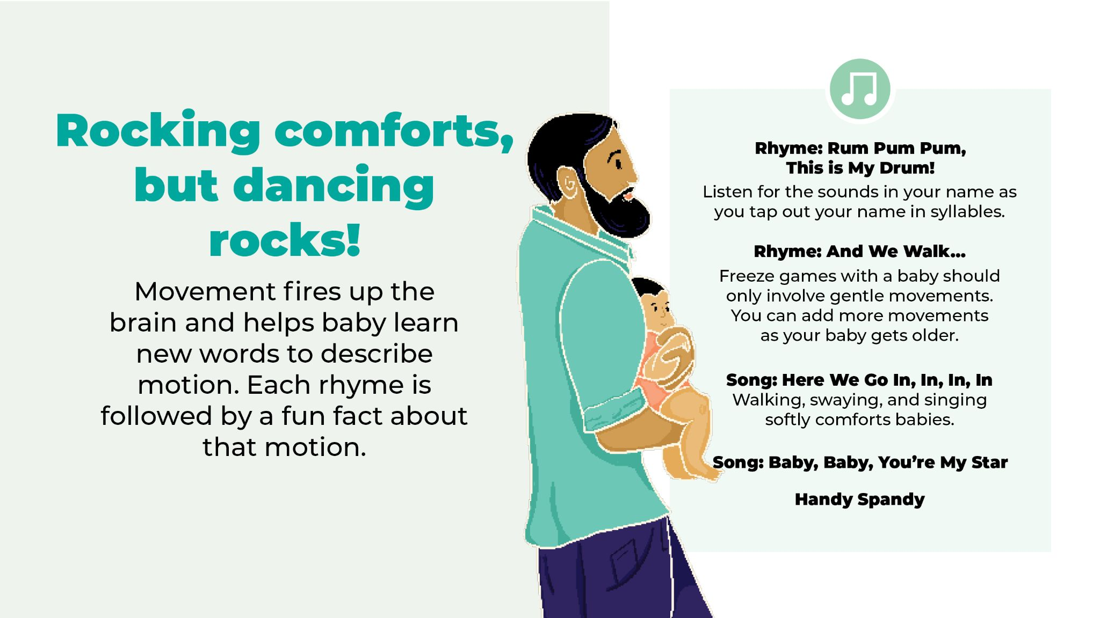
Notes:
• “Rum Pum Pum, This is My Drum”
• Tap your name!
• Freeze games help children practice stopping.
• “And We Walk…”
• “Here We Go In, In, In, In”
• Babies learn movement words by acting them out.
• Walking, swaying, and singly softly comforts babies.
• “Baby, Baby, You’re My Star”
• “Handy Spandy”
*****
Tapping on a tambourine (or drum) with your babies helps them develop an awareness of the parts of speech. By hearing the sounds between words, they begin to understand how words are made up of individual sounds. This skill includes breaking words down into smaller units, which is what we’re going to do right now.
Rum pum pum. This is my drum. (Tap to the beat.)
Rum pum pum. This is my drum.
My name is ( ). What’s your name?
(Tap your name with syllables on the drum. )
Anything can be a drum! You can use a book, a box of pasta, or anything else that you can tap.
For today , take your Hello, My World book out of the kit and pretend it is a drum. Recite “Rum Pum Pum” with me and tap out the syllables of your name and your baby’s name. For instance, Joe would just be Joe, but Shaniqua would be Sha-ni-qua with three syllables. (Demonstrate as you say the names.)
Since your children are too young to tap out their names on their own, please lift their hands and help them use their own hand to tap out the syllables of their name.
Let’s go around and try to give everyone a turn tapping out their name. When I say your name, unmute yourself and help your baby tap out his or her name. (Unmute everyone and try to see if this works! If you hear the spoken name, then repeat it back. Then give a friendly greeting. Even if you don’t hear the name, still give a greeting such as “Hello, Hi, I’m glad you’re here, Good to see you,” etc.)
(Once everyone has a chance to tap their name, sing “Drums Away.” Model putting your drum (or book) back into the tote bag. Then use the same sing-song voice to say: Everybody, stand up!)
Here’s a freeze game that is set to music. We’re going to march with our knees up high as we go around the room with our babies. But march gently in order to keep our babies safe.
(NOTE: This is a song; not the reciting version used earlier!)
We march, and we march, and we stop.
We march, and we march, and we stop
We march, and we march, and we march, and we march.
We march, and we march, and we stop.
(Repeat with a new action, i.e. walk, slink, sway, etc.)
Using words to describe your motions as you are doing them is another way to build your child’s vocabulary.
The rhythm and motion of walking around with your parent’s arms holding you securely reminds babies of being in the womb. It is a comforting, loving way to enjoy your time together.
Here’s a song to sing while you are holding your baby.
Here we go in, in, in
Here we go out, out, out.
Here we go in, in, in
And we turn ourselves about.
Here we go up, up, up, up.
And here we go down, down, down, down.
Here we go up, up, up, up.
With the sweetest baby in town. (end with a few kisses)
— Barbara Cass-Beggs
(Repeat)
Through this song, babies learn positional words such as in, out, up and down.
When your baby is restless, try walking or swaying while singing this newer version to “Twinkle, Twinkle”.
Tune of “Twinkle, Twinkle, Little Star”
Baby, baby (or use “Baby” and then substitute the baby’s name) you’re my star.
I love you just as you are.
You’re the apple of my eye,
You will grow to be so high.
Baby ( ), you’re my star.
I love you just as you are.
(Go immediately into the next rhyme without any introduction)
Handy Spandy, naptime is dandy, we all walk in.
Handy Spandy, naptime is dandy, we all walk out.
Handy Spandy, naptime is dandy, we turn around.
Handy Spandy, naptime is dandy, we all sit down.
(sit down)

Slide 7
Notes:
• Wiggle! March!
• “I Went to Visit the Farm One Day”
• “I Went to Visit the Store One Day”
• Brainstorm: How else can you u thatsong?
• “Books Away”
*****
Having conversations with your baby when doing something they may not like (such as having a bath or getting changed) can help to distract them. Describing what you are doing, singing about it, or asking questions such as “Will you wear the blue babygro or the purple polka-dot one?” strengthens the circuits in your baby's’ brain, which prepares them for future learning.
Take out Wiggle! March! from your kits. Although you will be returning it to us so we can sanitize it for next week’s session, today you will be getting your own copy of Wiggle! March! to take home and keep.
(Hold up the book & sing a song to go along with it. Paper clip the pages you plan on using such as horse, cow or rooster. Only sing about 3 or 4 animals)
Let’s practice singing the song about the sounds animals make.
I went to visit the farm one day.
I saw a horse across the way.
And what do you think the horse did say?
“Neigh, neigh, neigh.”
I went to visit the farm one day.
I saw a cow across the way.
And what do you think the cow did say?
“Moo, moo, moo.”
I went to visit the farm one day.
I saw a rooster across the way.
And what do you think the rooster did say?
Cock-a-doodle-doo!”
Don’t limit this song to Wiggle! March!; you can use it anywhere! When walking with your baby, talk or sing about what you see. For instance,
“I went to visit the store one day,
I saw a carrot along the way.
What color was the carrot that day?
Orange, orange, orange.”
Can anyone think of another way we could use this song in everyday life? Don’t forget that your babies don’t care if you can carry a tune or not. To them, your voice is the most beautiful sound in the world.
(Pause and unmute for answers. When done, put everyone on mute again.)
Thanks for all those great ideas. Please put your books back in your kits and take out your frog puppet. (Sing “Books Away”)

Slide 8
Notes:
• Sing and talk about the things your baby sees
• Children who can name body parts can tell you what hurts.
• “I Dropped My Frog”
• Use the puppet to talk with your baby.
• Use different voices and movements and see which ones your baby enjoys most.
• “Frogs Away”
*****
This week, we’re going to sing a fun song that names the parts of the body. By the time children enter kindergarten, they are expected to know the names of their body parts, and this song helps them to learn! As your babies grow older, don’t be surprised if they giggle when you sing this song with them!
I dropped my frog, pick it up, pick it up.
(Drop the frog into your lap)
I dropped my frog, pick it up, pick it up.
I dropped my frog, pick it up, pick it up.
And put it on my stomach.
Let’s do that again! (Repeat and choose whether or not you want to continue using other body parts. You can ask participants to call out body parts to use or to write them in the chat, if you are comfortable doing that.)
Now, let’s use the puppets to interact with our babies. you can use different voices and movements to engage them. Note which voice they respond to best. If you don’t know what to say, talk about the weather!
(Pause for parent/baby puppet interaction)
Time to put the puppets away using a song! Please drop your puppet back into the bag as we sing “Frogs Away.” Use this song or something similar to encourage your children to clean up when they are bigger!
Frogs away, frogs away, put your frogs away today.
Frogs away, frogs away, put your frogs away today.
(sing as many times as needed)

Slide 9
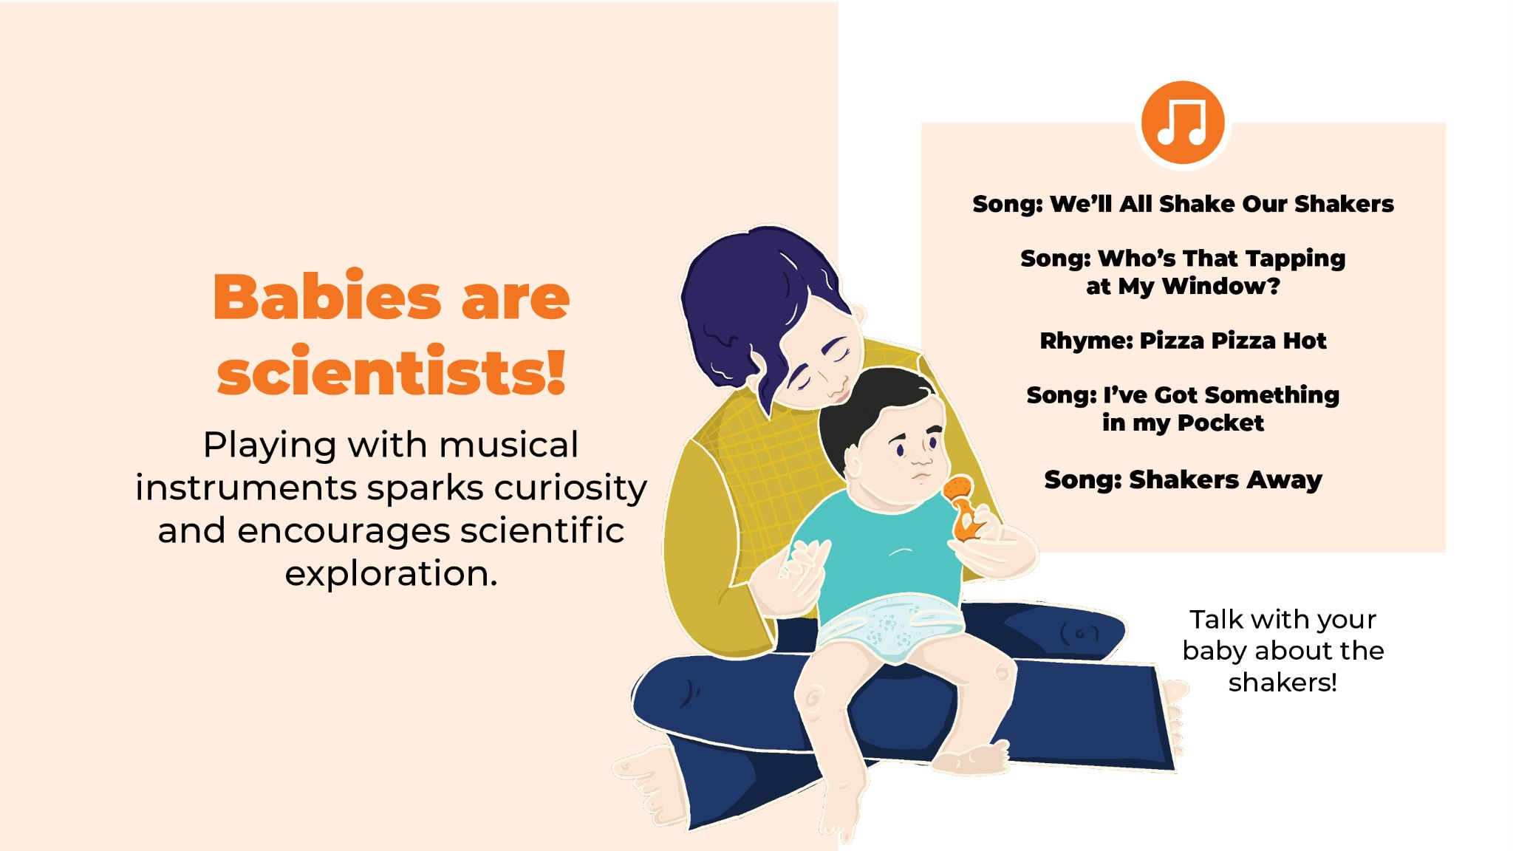
Notes:
• Babies are scientists
• Playing with musical instruments sparks curiosity and encourages scientific exploration.
• “Who’s That Tapping on My Shoulder?”
• “Pizza, Pizza Hot”
• “I’ve Got Something in my Pocket”
• Talk with your baby about the shakers.
• “Shakers Away”
• Optional: Music can make anything playful.
*****
Please take your shakers out of your kit. There should be one for you and one for your child. At this age, your baby probably won’t do much more than simply hold it or taste it. That’s fine. Soon enough your child will be shaking it around to the beat! Only use the shaker when your baby is supervised; any object that can fit into a toilet paper roll is a choking hazard, and we want your baby to stay safe.
Babies enjoy watching what a shaker does, hearing what it sounds like, and seeing how it looks when it’s in action. They like to feel the texture, perhaps exploring it with their tongue. Don’t worry, everything has been sanitized. Everything babies do is part of their learning, even though they’re so tiny. They are little scientists, always looking for the properties of objects and testing out what they can and can’t do. Playing with musical instruments sparks curiosity and encourages scientific exploration.
We’ll all shake our shakers, we’ll all shake our shakers,
We’ll all shake our shakers because it’s fun to do.
Shake them up high. (shake up high in a high voice)
Shake them down low. (shake down low in a low voice)
And shake them in the middle. (shake in front, using a normal voice)
Earlier today, we sang “Who’s That Tapping on My Shoulder?” Let’s sing it again, but this time, let’s shake our maracas to the beat as we sing. Don’t forget to replace “You” with the name of someone who your baby knows
Who’s that tapping on my shoulder?
Who’s that kissing on my head?
You are tapping on my shoulder.
You are kissing on my head
(Repeat, then go directly to the next rhyme without giving any directions - or substitute a song/rhyme of your choice)
Pizza, pizza hot. Pizza, pizza cold.
Pizza, pizza in the box, nine days old.
Some like it hot. Some like it cold.
Some like it in the box, nine days old. (Not me!) or (I do!)
(Repeat)
Now let’s put a smile on baby’s face and shake to the beat of this song!
I’ve got something in my pocket,
it belongs across my face.
I keep it very close at hand,
in a most convenient place.
I’m sure you couldn’t guess it
if you guessed a long, long while.
So I’ll take it out and put it on, it’s a Great Big Loving Smile!
I’ll bet you’re smiling now, too!
If your baby was holding or examining the shaker, talk about what you saw. When you’re talking about what babies look at and experiment with, you are more likely to help them learn new words than if you simply talk about something that they are not interested in or engaged with. Let’s take a minute to talk with our babies about the shakers.
(Talk with your “baby” as the parents talk with their babies.)
Time to put the shakers away! Drop them into your bags while singing the clean-up song with me.
Shakers away, shakers away, put your shakers away today.
Shakers away, shakers away, put your shakers away today.
(Sing as many times as needed.)
Isn’t cleaning up to a song fun? It’s like you’re playing a game rather than doing a chore. It’s amazing how music can make anything playful!

Slide 10
Notes:
• Parents need rest time too.
• The soft slow pace of lullabies helps you and your baby relax.
• “Too Ra Loo Ra Loo Ra”
*****
Time for a lullaby! Although having a baby is one of the happiest times of your life, it can also be one of the most exhausting. Just like your baby needs to take naps, you need to have time to rest also. Often, it’s easiest to take a nap while your baby is napping. This song is an Irish lullaby. The “Too Ra Loo Ra” part is fun to sing. And the soft, slow pace of the melody helps you and your baby to relax. If you know this song, please sing it along with me. Hold your babies close, where they can hear your heartbeat. Rock gently from side to side while singing this lullaby:
Too Ra Loo Ra Loo Ra, Too Ra Loo Ra Lie,
You’re my little hatchling, so here’s a lullaby.
Too Ra Loo Ra Loo Ra, Too Ra Loo Ra Lie,
Let’s both relax together, resting - you and I.
Too Ra Loo Ra Loo Ra, Too Ra Loo Ra Lie,
You’re my little hatchling, so here’s a lullaby.
Too Ra Loo Ra Loo Ra, Too Ra Loo Ra Lie,
Let’s both relax together, resting - you and I.
Now let’s sing it again. If you didn’t join in the first time, sing it with us now.
(Repeat.)

Slide 11
Notes:
• Visit the library!
Oh, the place for you and the place for me
is the local public library
They have books and things that they lend for free.
It’s the latest, it’s the greatest,
it’s the library.
Educational, informational,
entertainment that’s sensational
It’s a way of life, it’s for you and me.
It’s the latest, it’s the greatest, it’s the library.”
• Libraries have terrific free services:
• A library card lets you take materials home.
*****
Our last session is next week and I’d love to see you there! But don’t wait for a session to bring your baby to the library. Come any time we’re open. I’d love to visit with you and your baby. Even if I’m not there, you’ll find plenty for you and your baby to do at the library!
Let’s sing the library song:
Oh, the place for you and the place for me
is the local public library
They have books and things
that they lend for free.
It’s the latest, it’s the greatest, it’s the library.
Educational, informational,
Entertainment that’s sensational
It’s a way of life, it’s for you and me.
It’s the latest, it’s the greatest, it’s the library.”
Who knows how much a library card costs? (Pause for answers) That’s right, it’s free! You don’t need a library card to come into the library, to play with your baby in the children’s area, to attend programs, to use the computers, to read books, magazines, or newspapers. With a library card, you can borrow materials to take home with you. If you’re interested in getting a library card, talk with me after the session. (Or, fill in the specifics from your library).
The library’s hours are (fill in) and we’d love to see you there.

Slide 12
Notes:
• What is something new you heard?
• Which song or rhyme will you do at home with your baby?
• The more words your baby learns, the better!
• Talk, sing, share books, and play with your child.
• “Talk, Sing, Share Books, and Play”
*****
Studies show that the number of vocabulary words children know and can use when entering kindergarten affects their entire education and career, making it easier for them to learn how to read, which will help them in all stages of their lives. The best way to help your baby build a large vocabulary is easy -- share books, talk, sing, and play with your baby, starting from the very first moments you have together. Use the activities from Hatchlings and do them together at home.
Let’s sing the four practices’ song one more time!
Talk, sing, share books, and play.
Talk, sing, share books, and play.
Talk, sing, share books, and play.
Talk, sing, share books, and play -- Hooray!
Sing it with me! (Repeat)
I hope you found this session fun, with lots of good information. Let’s unmute ourselves or write in the chat box. Can each person tell us one new idea or action from this session that you hope to practice at home with your baby? If you’re comfortable sharing, I ‘d love to hear one thing that stood out for you today, something new that you learned or a rhyme or song that you intend to continue doing with your child at home. (Pause, unmute, and let participants share their thoughts).

Slide 13
Notes:
• Questions?
• Please fill out exit surveys
• If you don’t already have one, let us know and we’ll give you a bag, a calendar, and a song book
• This week you get the Wiggle! March! book; next week you get the frog puppet!
• Group picture time! Be sure your nametag shows.
• Thank you for coming! We’re glad you were here.
• Please join us again next week!
*****
Does anyone have any questions? (Pause for question and answer time)
If you have any family rhymes or songs that are your family’s favorites, please let me know and we can try to add them into next week’s program.
Hatchlings: In the Nest was created especially for new parents and their babies. I hope you found this session fun with lots of good information.
Let’s stand together for a group picture. Try to make sure your name tags are showing.
If you don’t already have one, let us know and we’ll give you a bag, a calendar, and a song book. If you’ve been to our earlier sessions, today you will get Wiggle! March!

Slide 14
Notes:
• Good-bye. Thanks for coming. I look forward to seeing you next week!
Goodbye, everyone. (if you can, say goodbye to everybody, including the babies, by name.)
I’m so glad you joined in today. Your babies are very lucky to have you as parents!
I look forward to seeing you next week!

