Slide 1
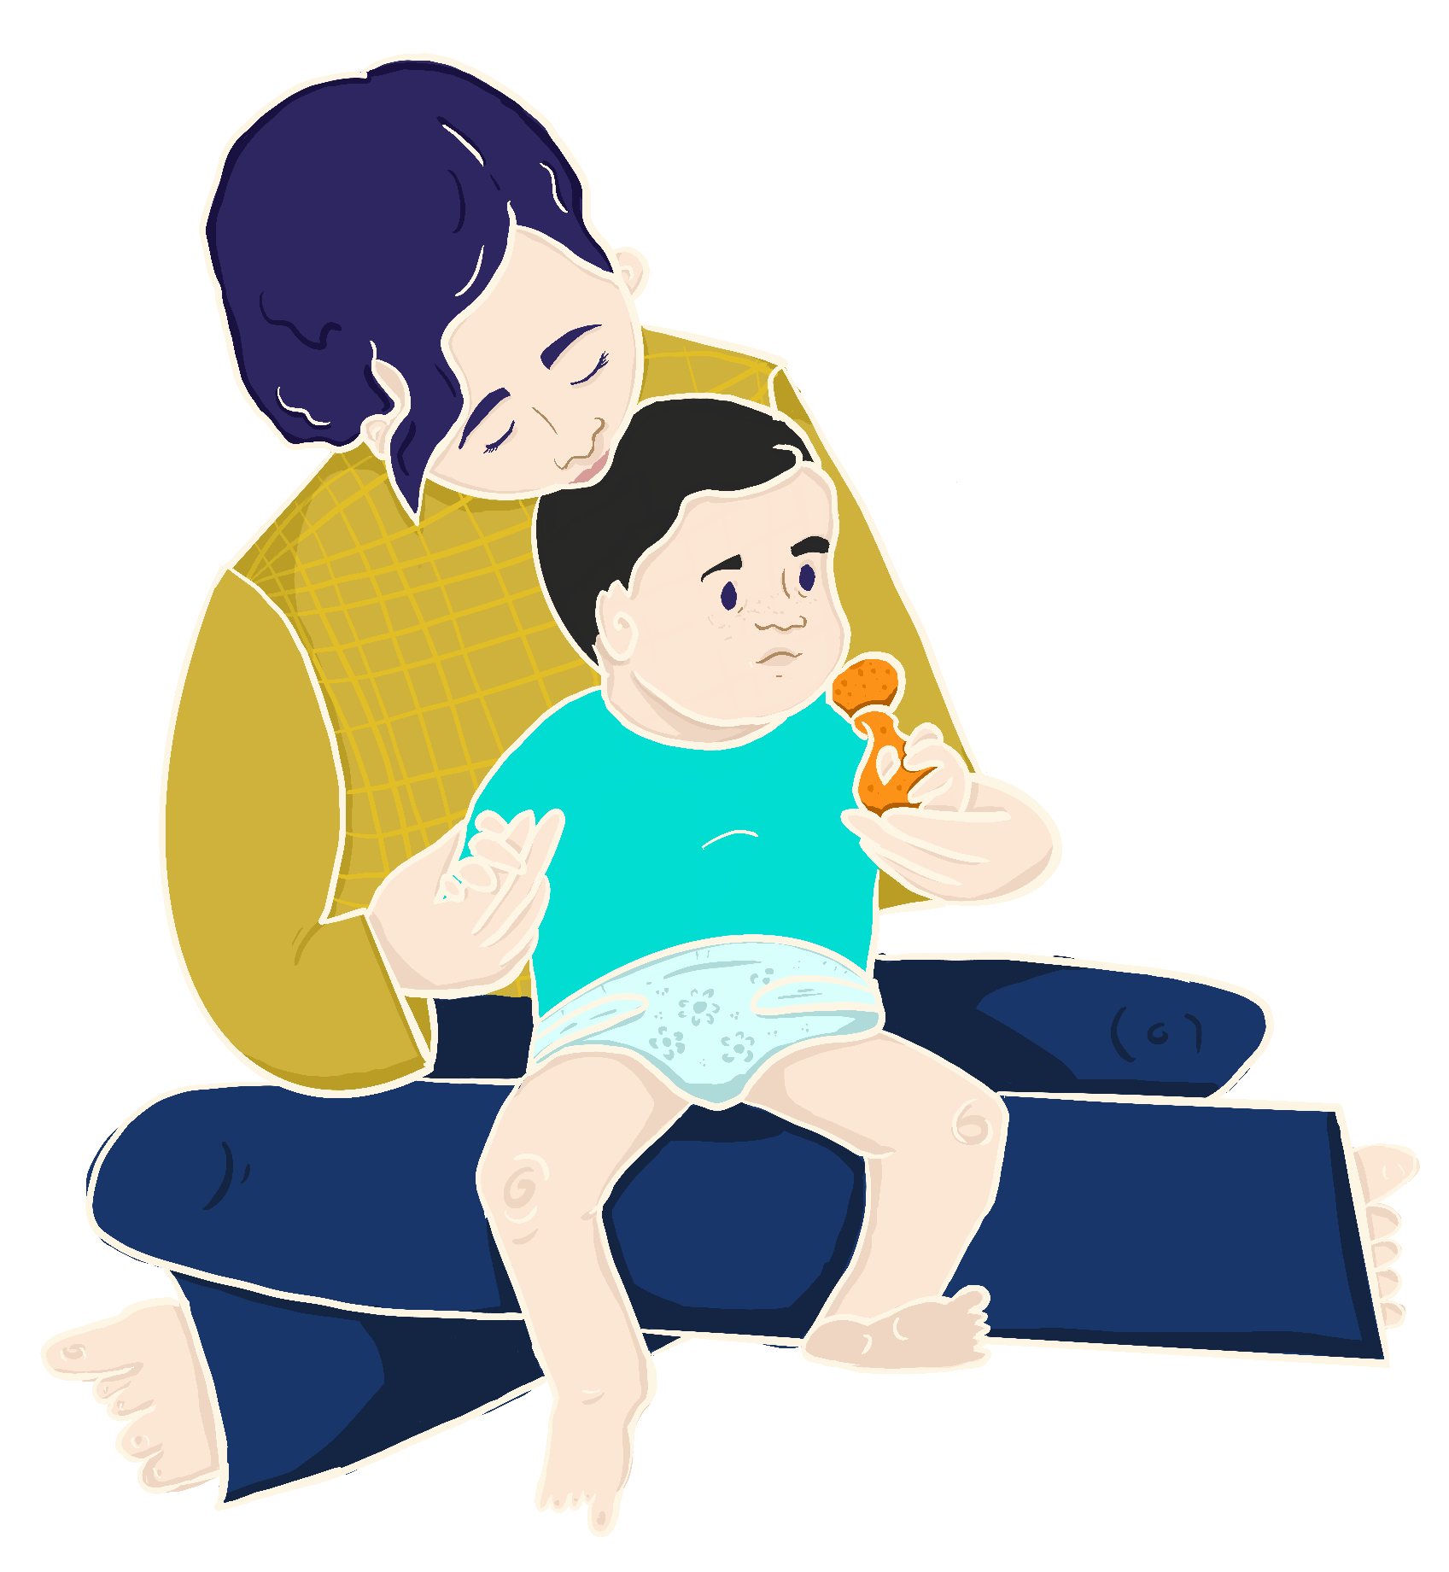
Mother Goose on the Loose | Hatchlings
Grow
Baby
with
In the Nest | Session 1
is a four-part early literacy program
for parents with babies from 0-4 months.
FREE family kit includes books, toys, a calendar, and activity booklet for attendees!
Space is limited to only newborns, infants, and their families for this session.
October 4, 2022 10:30-11:30am
This session is part of a four session program.
Fun Facts
Location
Reading and singing helps your baby’s brain and language development.
Reciting nursery rhymes & singing songs helps your baby get ready to learn to read.
Babies exposed to books and reading grow into children who perform better in school.
Fill in your location here
Baltimore, MD 20212
Registration is required. Please contact:
Patti Smith, psmith@gmail.com
(111) 867-5309
a
In partnership with:
b
c
“The MGOL Hatchlings materials were
developed with funds from the Maryland
State Department of of Education, Division of Early Childhood, as part of the PDG B-5 for MD State Libraries, funded through Grant Number 90TP0032-01-00 from the Office of Child Care, Administration for Children and Families, U.S. Department of Health & Human Services.”

Slide 2
Mother Goose on the Loose | Hatchlings
Grow
Baby
with
In the Nest | Session 1
is a four-part early literacy program
for parents with babies from 0-4 months.
FREE family kit includes books, toys, a calendar, and activity booklet for attendees!
Space is limited to only newborns, infants, and their families for this session.
October 4, 2022 10:30-11:30am
This session is part of a four session program.
Fun Facts
Location
Reading and singing helps your baby’s brain and language development.
Reciting nursery rhymes & singing songs helps your baby get ready to learn to read.
Babies exposed to books and reading grow into children who perform better in school.
Fill in your location here
Baltimore, MD 20212
Registration is required. Please contact:
Patti Smith, psmith@gmail.com
(111) 867-5309
a
In partnership with:
b
c
“The MGOL Hatchlings materials were
developed with funds from the Maryland
State Department of of Education, Division of Early Childhood, as part of the PDG B-5 for MD State Libraries, funded through Grant Number 90TP0032-01-00 from the Office of Child Care, Administration for Children and Families, U.S. Department of Health & Human Services.”

